Slide 1
Networking Concepts Basic networking before attempting to study cyber security is critical. Also, be aware this is just a brief introduction of basic network concepts

Slide 2
NETWORK TOPOLOGIES
A Network Topology is the arrangement with which computer systems or network Devices are connected to each other.
For communication to occur, two devices must be connected in some way to the same link at the same time
A network is simply a way for machines / computers to communicate.

Slide 3
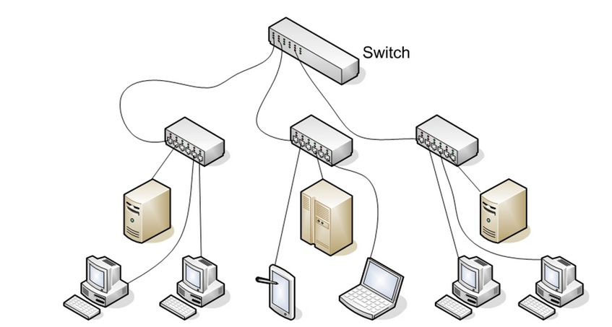

Slide 4
The real essence of networks is communication allowing one machine to communicate with another
•Documents
•Email and messaging
•Websites
•Databases
•Music
•Printers and faxes
•Telephony and videoconferencing
Every path of communication is also a possibility for an attack.

Slide 5
Detailed understanding of how computers communicate over a network.
Network interface cards,
switches,
routers,
hubs,
firewalls are the fundamental physical pieces of a network.

Slide 6
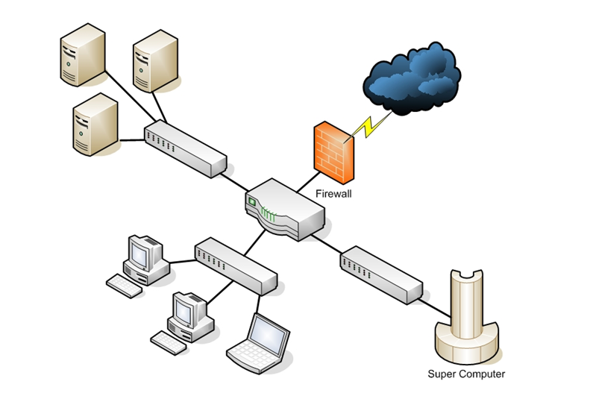

Slide 7
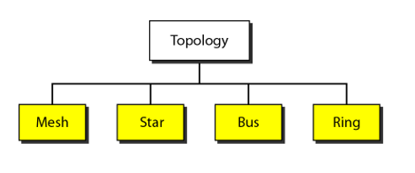
Categories of Topology

Slide 8
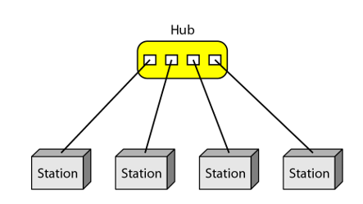
Star Topology
In a star topology, each device has a dedicated point-to-point link only to a central controller, usually called a hub
The devices are not directly linked to one another.
A star topology does not allow direct traffic between devices

Slide 9
Advantages
Disadvantages
A star topology is less expensive
It easy to install and reconfigure
Robustness
One big disadvantage of a star topology is the dependency of the whole topology on one single point, the hub

Slide 10
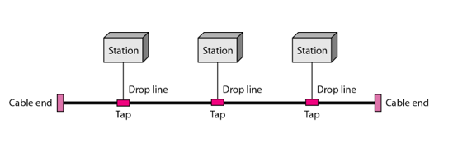
Bus Topology
Bus topology ,all devices share single communication line or cable
One long cable acts as a backbone to link all the devices in a network
Nodes are connected to the bus cable by drop lines and taps.

Slide 11
Advantages
Disadvantages
Ease of installation
Bus uses less cabling
Difficult reconnection and fault isolation
Difficult to add new devices
Bus topology was the one of the first topologies used in the design of early local-area networks.

Slide 12
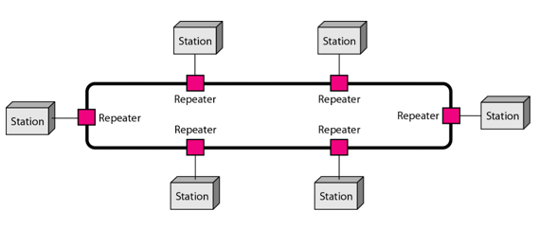
Ring Topology
Each host machine connects to exactly two other machines, creating a circular network structure.
A signal is passed along the ring in one direction, from device to device, until it reaches its destination.

Slide 13
Advantages
Disadvantages
A ring is relatively easy to install and reconfigure
A ring is better at handling load
A central server is not required for the management of this topology
Data sent from one node to another has to pass through all the intermediate nodes.
The transmission speed drops with an increase in the number of nodes.
The failure of a single node in the network can cause the entire network to fail

Slide 14
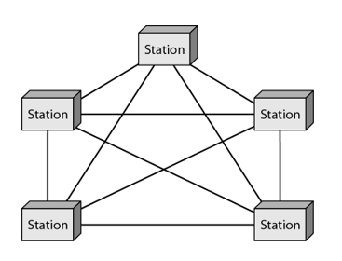
Mesh Topology
In a mesh topology, every device has a dedicated point-to-point link to every other device.
The term dedicated means that the link carries traffic only between the two devices it connects.

Slide 15
Advantages
Disadvantages
It can handle heavy traffic, as there are dedicated paths between any two network nodes.
The failure of a single node does not cause the entire network to fail as there are alternate paths for data transmission
A lot of cabling is required
Costs incurred in setup and maintenance are high.
Administration of a mesh network is difficult.

Slide 16
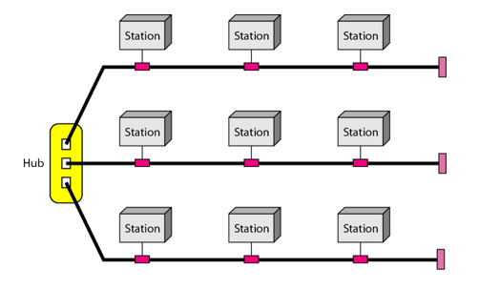
Hybrid Topology
It is two different types of topologies which is a mixture of two or more topologies.
For example if in an office in one department ring topology is used and in another star topology is used, connecting these topologies will result in Hybrid Topology

Slide 17
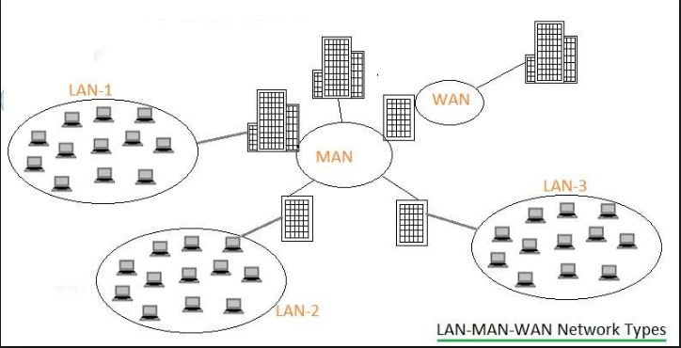

Slide 18
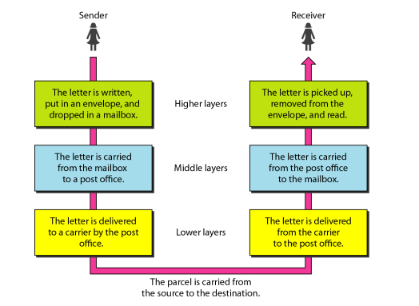
Layered communication

Slide 19

THE OSI MODEL
The International Standards Organization (ISO) is a multinational body dedicated to worldwide agreement on international standards
The Open Systems Interconnection (OSI) model.
It was first introduced in the late 1980s.

Slide 20
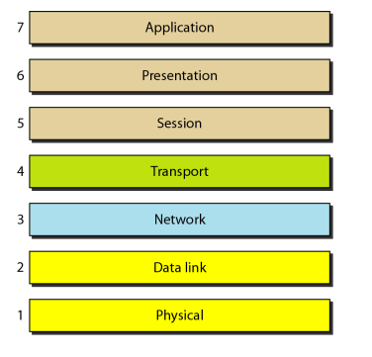
Seven layers of the OSI model

Slide 21
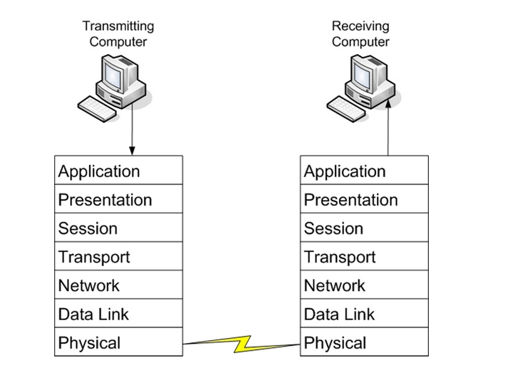
Open Systems Interconnection (OSI) model
The OSI model is not a protocol; it is a model for understanding and designing a network architecture that is flexible, robust, and interoperable

Slide 22
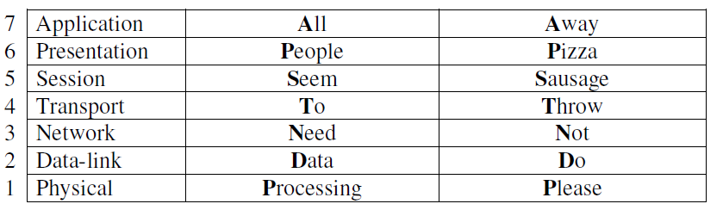
Various mnemonics
Make it easier to remember the order of the OSI model’s layers

Slide 23
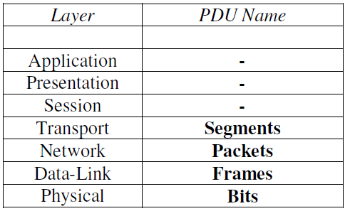
Protocol Data Units (PDUs)
OSI model, each layer adds a header containing protocol information specific to that layer.
These headers are called Protocol Data Units (PDUs), and the process of adding these headers is called encapsulation.

Slide 24
Physical layer
The Physical layer (Layer-1) controls the signalling and transferring of raw bits onto the physical medium
The Physical layer provides specifications for a variety of hardware:
• Cabling
• Connectors and transceivers
• Network interface cards (NICs)
• Wireless radios
• Hubs

Slide 25
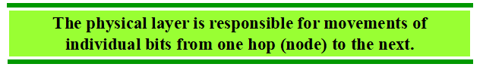
Protocol Data Units (PDUs) = Bits
The physical layer coordinates the functions required to carry a bit stream over a physical medium.

Slide 26
Physical characteristics
Representation of bits (Os and I s).
Data rate.
Physical topology.
Transmission mode.

Slide 27

Data Link Layer
The Data-link layer packages the higher-layer data into frames,
The data-link frame contains the source and destination hardware (or physical) address
The most common hardware address is the Ethernet MAC address.

Slide 28
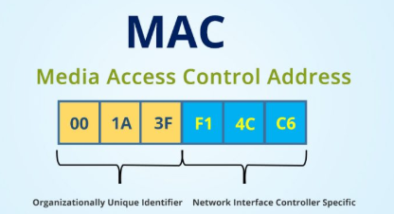
Protocol Data Units (PDUs) = Frames
Physical addressing. If frames are to be distributed to different systems on the network,
The data link layer adds a header to the frame to define the sender and/or receiver of the frame

Slide 29

Network Layer
The network layer is responsible for the source-to-destination delivery of a packet, possibly across multiple networks (links).
The network layer ensures that each packet gets from its point of origin to its final destination

Slide 30
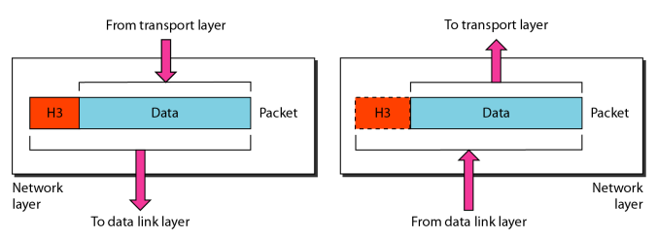
Protocol Data Units (PDUs) = Packets
Responsibilities of the network layer :-
Logical addressing
Routing.

Slide 31
A packet can have multiple headers.
The IP header has information such as IP addresses for the source and destination,
what protocol the packet
TCP header has information such as port number
Ethernet header has information such as the MAC address for the source and destination

Slide 32

The Transport Layer
Transport layer communication falls under two categories:
• Connection-oriented – requires that a connection with specific agreed-upon parameters be established before data is sent.
• Connectionless – requires no connection before data is sent.

Slide 33
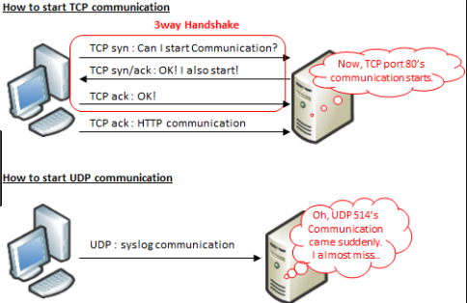
The TCP/IP protocol suite incorporates two Transport layer protocols:
• Transmission Control Protocol (TCP) – connection-oriented
• User Datagram Protocol (UDP) - connectionless

Slide 34
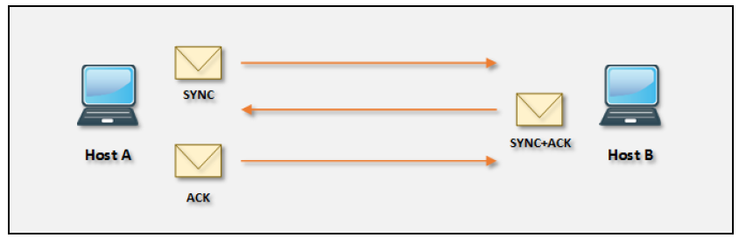

Slide 35
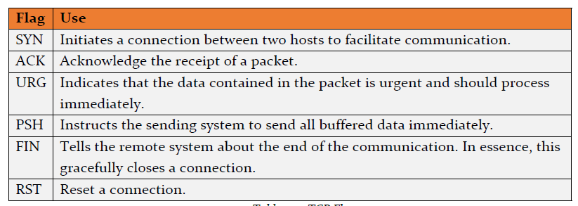
6 TCP flags:

Slide 36


Slide 37
Responsibilities of the transport layer
Service-point addressing
Connection control
Flow control.

Slide 38
Example
For example, a Transport layer protocol such as TCP will add a header containing flow control, port numbers, and sequencing.
The Network layer header contains logical addressing information,
The Data-link header contains physical addressing and other hardware specific information

Slide 39

Session Layer
The services provided by the first three layers (physical, data link, and network) are not sufficient for some processes.
The Session layer (Layer-5) is responsible for establishing, maintaining, and ultimately terminating sessions between devices
If a session is broken, this layer can attempt to recover the session.

Slide 40
Responsibilities of Session Layer
Dialog control : - The session layer allows two systems to enter into a dialog. It allows the communication between two processes
Synchronization:- The session layer allows a process to add checkpoints, or synchronization points, to a stream of data.
Example, if a system is sending a file of 2000 pages, it is advisable to insert checkpoints after every 100 pages to ensure that each 100-page unit is received and acknowledged independently

Slide 41
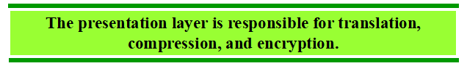
Presentation Layer
The presentation layer is concerned with the syntax and semantics of the information exchanged between two systems.
This ensures that data from the sending application can be understood by the receiving application

Slide 42
Responsibilities
Translation :- The processes in two systems are usually exchanging information in the form of character strings, numbers, and so on. Their must be change of bit streams before being transmitted (encoding)
Encryption :- To carry sensitive information, a system must be able to ensure privacy.
Compression :- Data compression reduces the number of bits contained in the information. such as text, audio, and video

Slide 43
Presentation layer formats include
Text - RTF, ASCII, EBCDIC
Images - GIF, JPG, TIF
Audio - MIDI, MP3, WAV
Movies - MPEG, AVI, MOV

Slide 44

Application Layer
The application layer enables the user, whether human or software, to access the network.
It provides user interfaces and support for services such as electronic mail, remote file access and transfer, shared database management, and other types of distributed information services.

Slide 45
Examples of Application layer protocols include:
FTP, via an FTP client
HTTP, via a web browser
POP3 and SMTP, via an email client
Telnet
Responsibilities :-
File transfer, access, and management
Mail services – (e-mail Storage)
Directory Services :- Distributed Data Base Sources and Access for Global information.

Slide 46
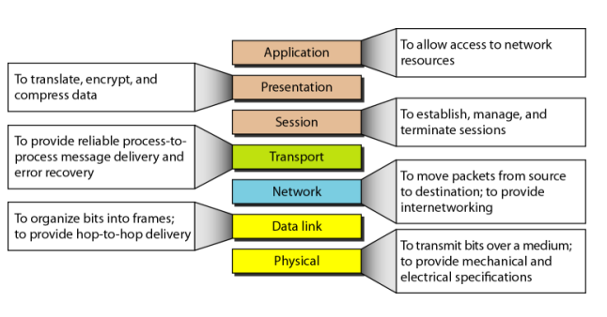
Summary of layers

Slide 47
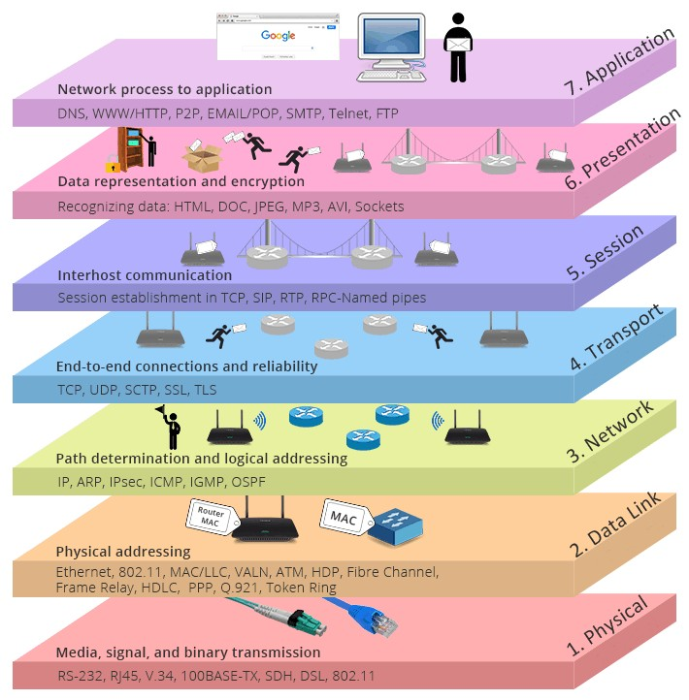

Slide 48
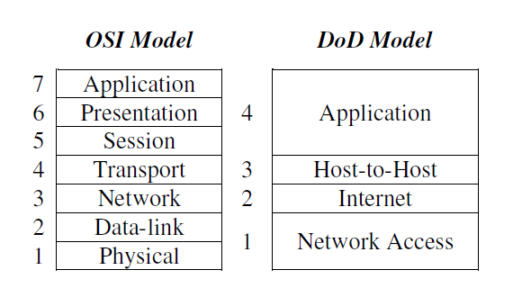
TCP/IP PROTOCOL SUITE
The DoD (Department of Defense) developed their own networking model, which became known as the DoD or TCP/IP Model.

Slide 49
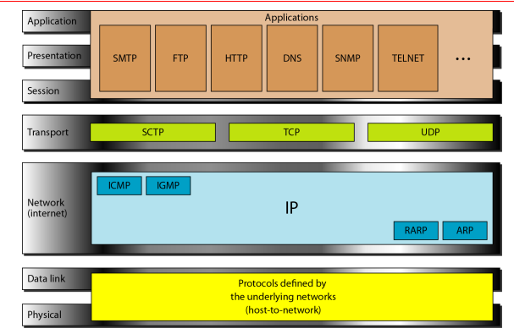
Layers
Notes:
At the transport layer, TCP/IP defines three protocols: Transmission Control
Protocol (TCP), User Datagram Protocol (UDP), and Stream Control Transmission
Protocol (SCTP).

Slide 50
IP Address / Port Numbers

Slide 51
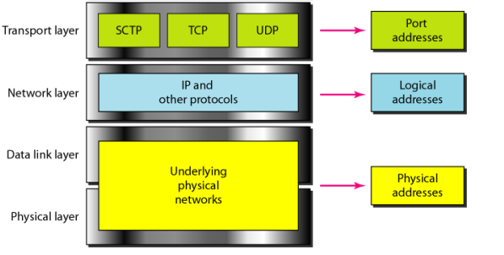

Slide 52
Internet Protocol address (IP address)
An Internet Protocol address (IP address) is a unique number assigned to each computer or device (such as printer) so that each of them can be uniquely identified on the network
Internet Protocol Versions
Two version of Internet Protocol (IP): IPv4 and a new version called IPv6
IPv4 was the first version of IP. It was deployed for production in the ARPANET in 1983. Today it is most widely used IP version
IPv4 uses a 32-bit address (4 billion addresses)
IPv6 is the most recent version of the Internet Protocol.
IPv6 Uses a 128-bit address

Slide 53
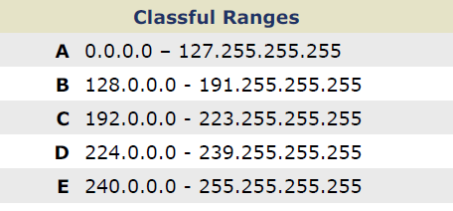
Range of IPv4

Slide 54
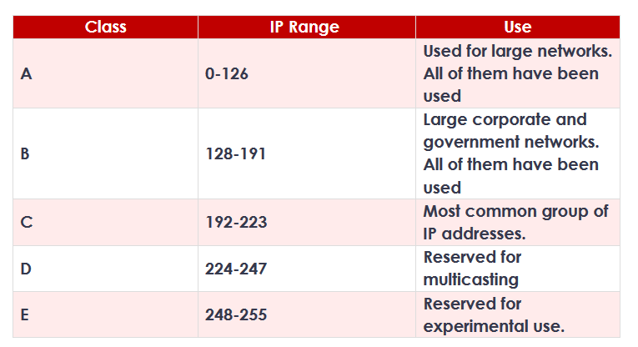

Slide 55
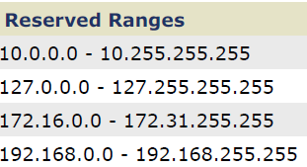
Types of IP Address
Private IP Address: A private IP address is the one that is assigned to a computer on the Local Area Network (LAN).
Example : 192.168.0.2
Public IP Address: A public IP address is the one that is assigned to a computer connected to the Internet.
Example : 59.93.115.125

Slide 56
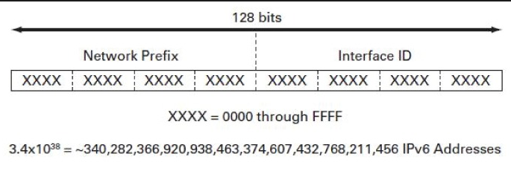
IPv6
An IPv6 address is a 128-bit alphanumeric string that identifies an endpoint device in the Internet Protocol Version 6 (IPv6) addressing scheme.
IPv6 address is 128 bits long and is arranged in eight groups
Example : FE80:CD00:0000:0CDE:1257:0000:211E:729C

Slide 57
NETWORK PORT
A computer may be running several services on it like HTTP (web server), SMTP, FTP and so on
Each of these services are uniquely identified by a number called network port
The range for port numbers is 0 – 65535, for both TCP and UDP
Example : 192.168.60.125:443
The first 1024 ports (0-1023) have been reserved for widely-used services, and are recognized as well-known ports

Slide 58
Protocols/Services
Hyper Text Transfer Protocol (HTTP)
Example: http://www.example.com
File Transfer Protocol (FTP)
Example: ftp://www.example.com
Simple Main Transfer Protocol (SMTP)
The Simple Mail Transfer Protocol provides a standard for sending e-mails from one server to another.
Telnet : is a network protocol that allows you to connect to remote hosts on the Internet or on a local network.
Example :telnet 127.0.0.1 25
SSH (Secure Shell)

Slide 59
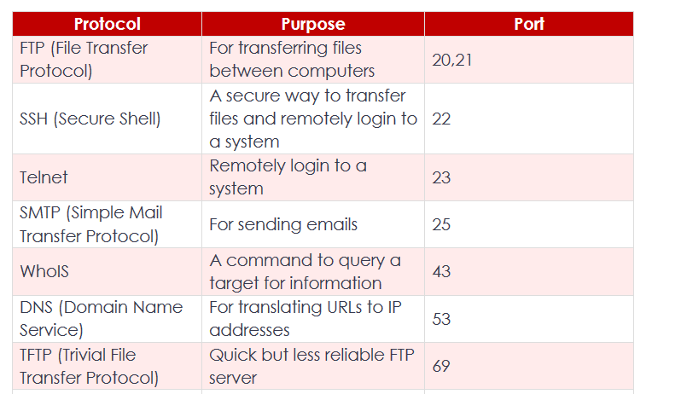
Well Known Port Numbers

Slide 60
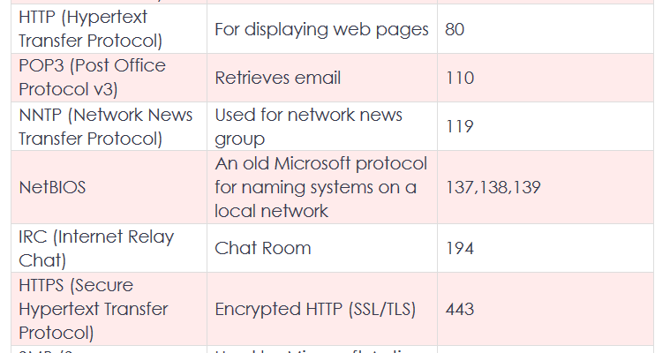

Slide 61
Introduction to Ethical Hacking

Slide 62
Cyber Security
The methods and processes to protect information and information systems from unauthorized access, the disclosure of information, usage or modification.
Information security ensures the confidentiality, integrity, and availability.
security policies
computer security, hacking simply refers to the act of exploiting the weakness that exists in a computer system or a computer network

Slide 63
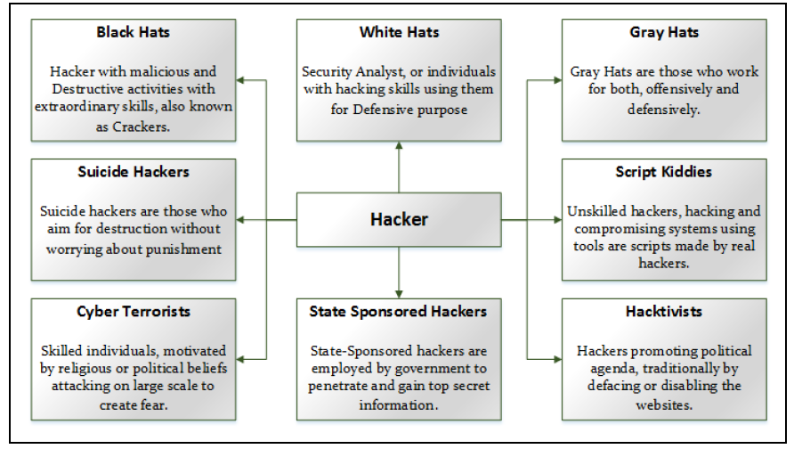
Types of Hackers

Slide 64
Essential Terminology
Zero-Day Attack
Threats and vulnerabilities that can exploit the victim before the developer identify or address
Vulnerability
Weak point, loophole
Daisy Chaining
Sequential process of several hacking or attacking attempts
Exploit
Breach of security of a system through Vulnerabilities, Zero-Day Attacks
Payload
Payload is a section or part of a malicious and exploited code

Slide 65
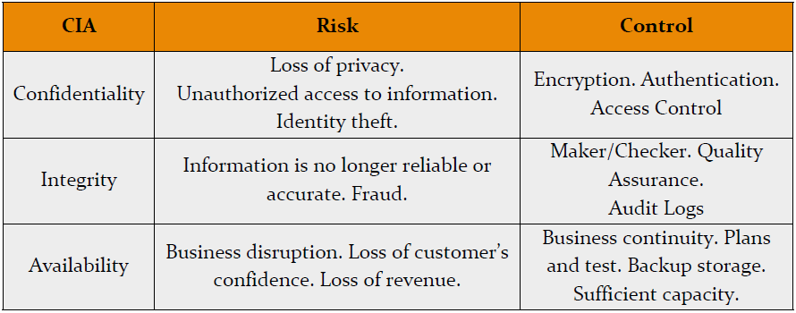
Elements of Cyber Security

Slide 66
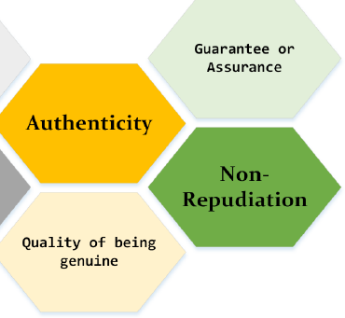
Authenticity
Authentication is the process which identifies the user, or device to grant privileges, access and certain rules and policies.
valid user
Non-Repudiation
The sender cannot deny from what he sent
The receiver cannot deny from receiving

Slide 67
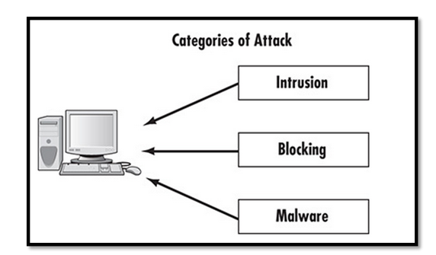
Cyber Security Attack Vectors

Slide 68
Viruses
“Virus" in Network and Information security describes malicious software
They spread, replicate themselves, and attach themselves to other files
user interaction required
Worms
Worms are capable of replicating themselves
Botnets
Perform repetitive task
The most often of botnets are in connection with Internet Relay Chat.
Botnets are illegal and legal

Slide 69
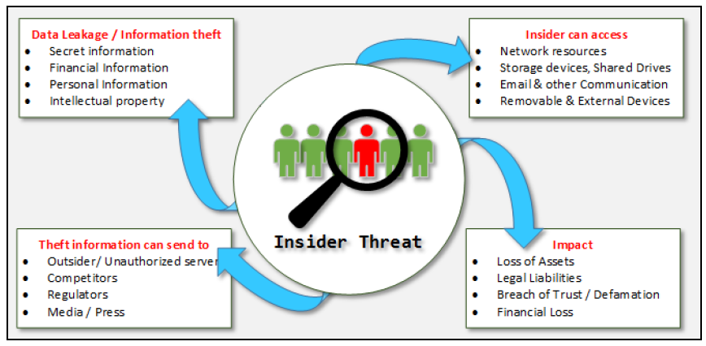

Slide 70
Security Threat Categories
Network Threats
Components of network infrastructure are routers, switches, and firewalls
They also control and protect the running applications, servers, and devices from attacks and intrusions
Common vulnerabilities on the network include
Default installation settings
Open access controls
Weak encryption & Passwords
Devices lacking the latest security patches

Slide 71
Top network level threats include:
Information gathering
Sniffing & Eavesdropping
Man-in-the-Middle Attack
Password-based Attacks
Denial-of-Services Attacks
Firewall & IDS Attacks

Slide 72
Host Threats
Host threats are focused on system software; Applications are built or running over this software such as Windows 2000, .NET Framework, SQL Server, and others.
Malware Attacks
Unauthorized Access
Privilege Escalation
Backdoor Attacks
Physical Security Threats

Slide 73
Operating System Attacks :-
Attackers always search for an operating system's vulnerabilities. If they found any vulnerability in an Operating System, they exploit to attack against the operating system
Bugs in the operating system
Unpatched operating system
Misconfiguration Attacks

Slide 74
Buffer overflow
Buffer Overflow is one of the major Attacks related to software/application exploitation attacks
when a program or application does not have well-defined boundaries such as restrictions or pre-defined functional area regarding the capacity of data it can handle or the type of data can be inputted
Buffer overflow causes Denial of Service (DoS), rebooting, achievement of unrestricted access and freezing
For example, if the buffer can hold 1024 bytes of data and you try to fill it with 2048 bytes, the extra 1024 bytes is then simply loaded into memory.

Slide 75
Hacking
Term "Hacking" in information security refers to exploiting the vulnerabilities in a system, compromising the security to gain unauthorized command and control over the system resources.
The following are the five phases of hacking: -
1. Reconnaissance
2. Scanning
3. Gaining Access
4. Maintaining Access
5. Clearing Tracks

Slide 76
Reconnaissance
Gathering the information about the target before launching an attack using different tools and techniques.
Information about the target website (domain name) such as the name of its owner and registrar, date of its registration, expiry date, name servers associated, contact details associated with it such as email, phone and address
Two types of Reconnaissance
Passive Reconnaissance
Active Reconnaissance

Slide 77
Passive Reconnaissance, the hacker is acquiring the information about target without interacting the target directly
Example :- Public or Social Media searching, Internet Searching
ActiveReconnaissance, the hacker is acquiring the information about target with interacting the target directly
Example :- Calls, E-Mails.

Slide 78
Scanning
Scanning phase is a pre-attack phase. In this phase, attacker scans the network by information acquired during the initial phase of reconnaissance
Examples :- Port Scanners, Network Mappers, Ping Vulnerabilities scanner.
Information Gained :- Port Status, Operating System information, Device type, Live machines.

Slide 79
Gaining Access
Gaining access phase of hacking is the point where the hacker gets the control over an operating system, application or computer network
Access level operating system level, application level or network level access.
Examples :- password cracking, denial of service, session hijacking or buffer overflow and others are used to gain unauthorized access

Slide 80
Maintaining Access
Maintaining access phase is the point when an attacker is trying to maintain the access, ownership & control over the compromised systems
Attacker prevents the owner from being owned by any other hacker
Examples :- Backdoors, Rootkits or Trojans to retain their ownership
Escalation of Privileges
In this phase, an attacker may steal information by uploading the information to the remote server, download any file on the resident system, and manipulate the data and configuration.

Slide 81
Clearing Tracks
An attacker must hide his identity by covering the tracks
To manipulate the identity and evidence, the attacker overwrites the system, application, and other related logs to avoid suspicion
Covering track is most required for an attacker to fulfil their intentions by continuing the access to the compromised system, remain undetected & gain what they want, remain unnoticed and wipe all evidence that indicates his identity.

Slide 82
Ethical Hacking
Ethical hacking and penetration testing are common terms, popular in information security environment for a long time.
Security experts deficiencies in running systems, applications, software and addressing security threats proactively
Ethical hacking are to uncover the vulnerabilities in systems and security deployments to take action to secure them before they are used by a hacker to breach security

Slide 83
Phases of Ethical Hacking
Ethical Hacking is the combination of the following phases: -
1. Foot printing & Reconnaissance
2. Scanning
3. Enumeration
4. System Hacking
5. Escalation of Privileges
6. Covering Tracks

Slide 84
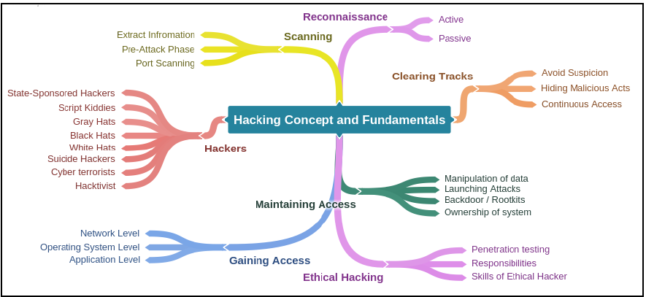
Mind Map

Slide 85
Foot printing Methodology
Get information regarding anyone as the internet, social media, official websites and other resources have much information.
About their users which are not sensitive, but a collection of information may fulfil the requirements of an attacker and attacker can gather enough information by a little effort

Slide 86
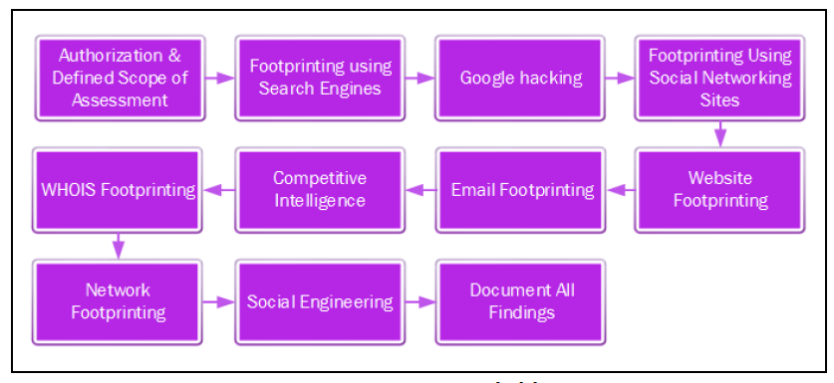

Slide 87
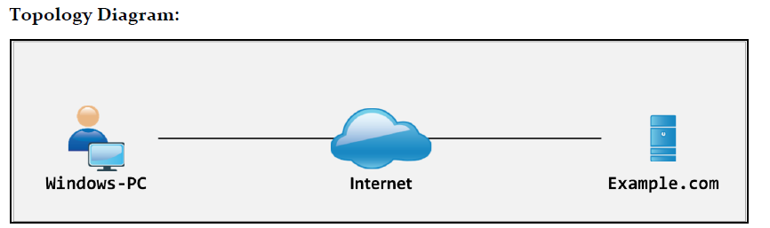
Gathering information using Windows Command Line Utilities
Using Windows-based tools, let's gather some information about the target

Slide 88
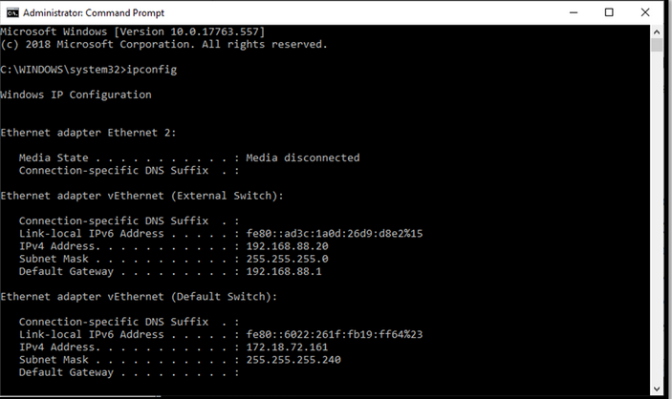
Basic Network Utilities
Ipconfig :- Gives you information about your connection to a network

Slide 89
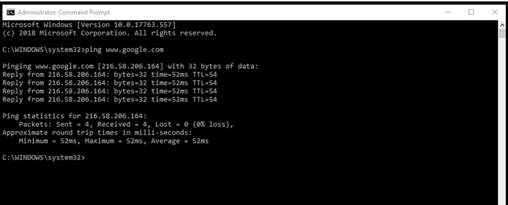
Ping : Ping is used to send a test packet, or echo packet, to a machine to find out whether the machine is reachable and how long the packet takes to reach the machine

Slide 90
From the output, you can observe and extract the following information:
1. Example.com is live
2. IP address of example.com.
3. Round Trip Time
4. TTL value TTL means “time to live.
5. Packet loss statistics

Slide 91
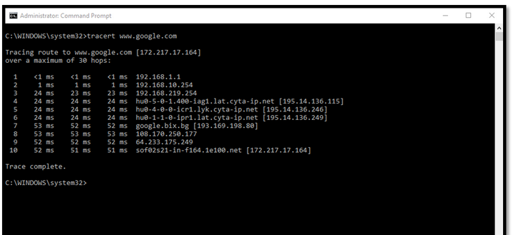
Tracert : Tracert not only tells you whether the packet got there and how long it took, but it also tells you all the intermediate hops it took to get there.

Slide 92
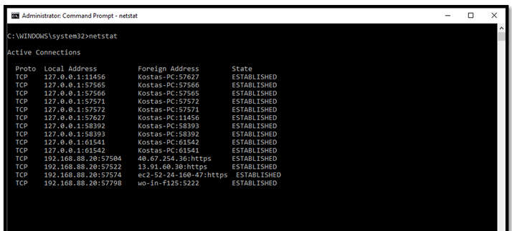
Netstat (Network Status) : This command tells you what connections your computer currently has.
These four (ipconfig, ping, tracert, and netstat) are absolutely essential to any network administrator

Slide 93
Foot printing through Social Networking Sites
Social Engineering in Information Security refers to the technique of psychological manipulation.
This trick is used to gather information from different social networking and other platforms from people for fraud, hacking and getting information for being close to the target.

Slide 94
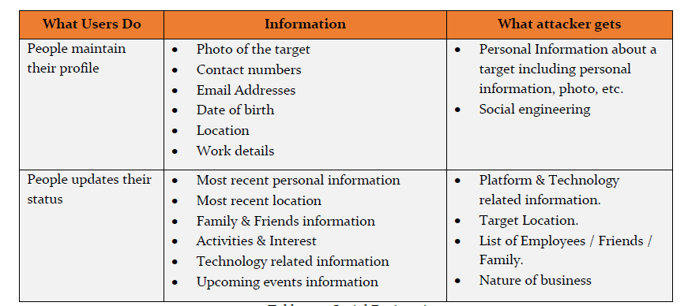

Slide 95
Website Footprinting
Website Foot printing includes monitoring and investigating about the target organization's official website for gaining information such as
Software running, versions of these software’s,
operating systems,
Sub-directories, database
scripting information.
Popular website for searching the detailed information regarding websites is Shodan, i.e. www.shodan.io.
Notes:
https://web.archive.org

Slide 96
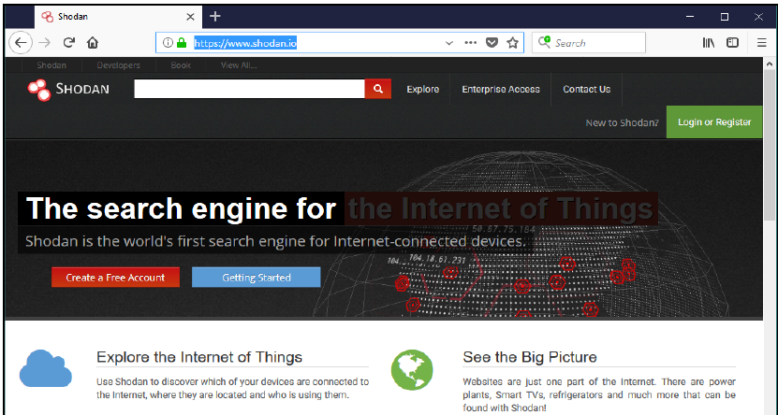
SHODAN search engine lets you find connected devices such as router, servers, IoT & other devices by using a variety of filters.

Slide 97
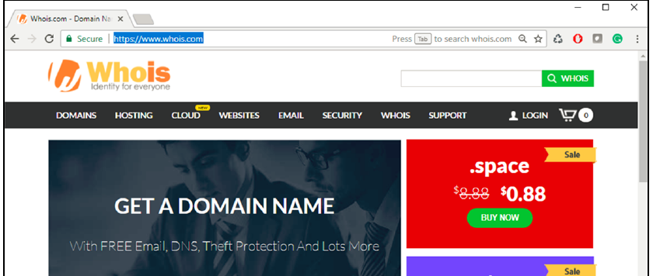
WHOIS Footprinting
"WHOIS" helps to gain information regarding domain name, ownership information.
IP Address, Domain Name Servers and other information’s.
Regional Internet Registries (RIR) maintain WHOIS database.

Slide 98
Eavesdropping
Eavesdropping is a type of Social Engineering foot printing in which the Social Engineer is gathers information by listening to the conversation covertly.
Listening conversations includes listening, reading or accessing any source of information without being notified.
Shoulder Surfing
Shoulder Surfing is another method of gathering information by standing behind a target when he is interacting with sensitive information.
By Shoulder surfing, passwords, account numbers, or other secret information can be gathered depending upon the carelessness of the target.

Slide 99
Dumpster Diving
Dumpster Diving is the process of looking for treasure in trash. This technique is older but still effective.
It includes accessing the target's trash such as printer trash, user desk, company's trash for finding phone bills, contact information’s, financial information, source codes, and other helpful material.

Slide 100
Scanning Networks
After “Foot printing phase”, you may have enough information about the target. Now Scanning network phase requires some of this information to proceed further.
Network Scanning is a method of getting network information such as identification of hosts, port information, and services by scanning networks and ports

Slide 101
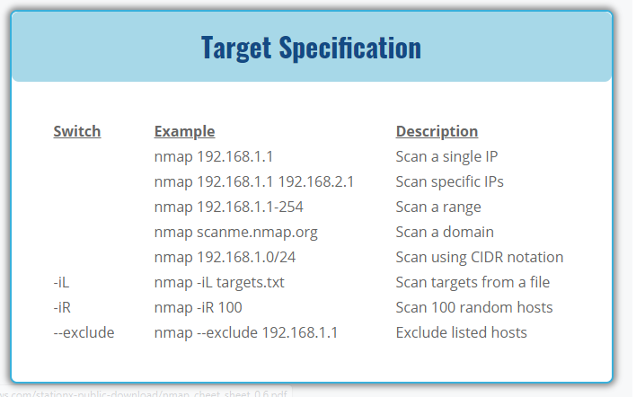

Slide 102
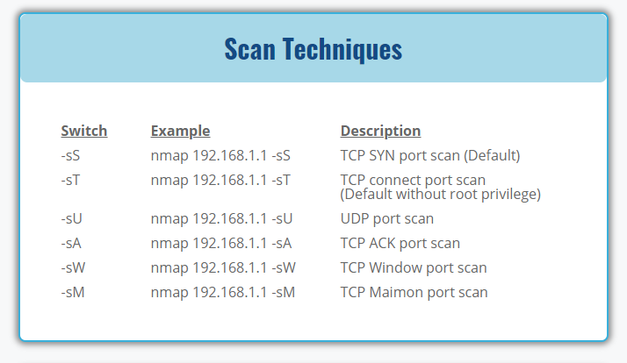

Slide 103
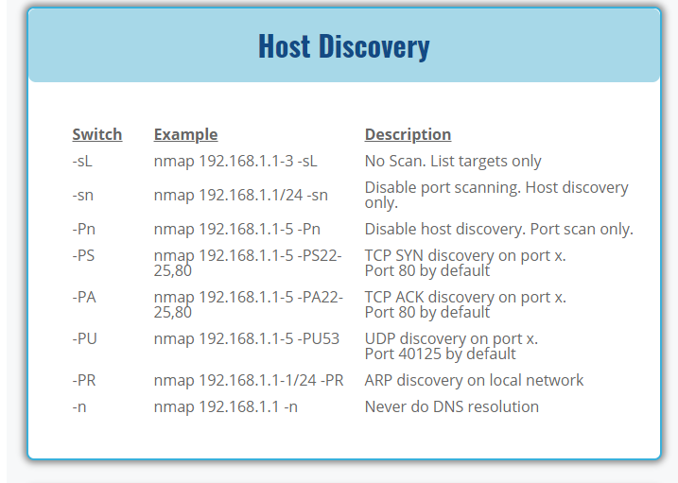

Slide 104


Slide 105


Slide 106


Slide 107


Slide 108

6 TCP flags

Slide 109
Scanning Methodology
Checking for live systems
Discovering open ports
ICMP Scanning
SSDP Scanning (Simple Service Discovery Protocol)

Slide 110
Hping3
Hping is a command-line TCP/IP packet assembler and analyzer tool that is used to send customized TCP/IP packets and display the target reply as ping command display the ICMP Echo Reply packet from targeted host.
Using Hping, the following parameters can be performed: -
Test firewall rules.
Advanced port scanning.
Testing net performance.
Traceroute-like under different protocols.
Remote OS fingerprinting & others.

Slide 111

TCP Connect / Full Open Scan

Slide 112

Stealth Scan (Half-open Scan)

Slide 113

Xmas Scanning
Xmas Scan is the type of scan in which contains multiple flags. Packet sent to the target along with URG, PSH & FIN; or a packet having all flags creates an abnormal situation for the receiver.

Slide 114
Enumeration
Enumeration is defined as the process of extracting user names, machine names, network resources, shares and services from a system
In this phase, the attacker creates an active connection to the system and performs directed queries to gain more information about the target.
The gathered information is used to identify the vulnerabilities or weak points in system security and tries to exploit in the System gaining phase.

Slide 115
Information that is enumerated in this phase are: -
Machine Name
User Information
Group Information
Application and Banners
Network Sharing Information
Network Resources

Slide 116
Enumeration Using Email ID
Extraction of information using Email ID can provide useful information like username, domain name, etc. An Email address contains username and domain name in it.
Enumeration using Default Password
Another way of enumeration is using default passwords. Every device and software has its default credentials and settings.
This default setting and configuration are recommended to be changed. Some administrators keep using default passwords and settings.
It became so easy for an attacker to gain unauthorized access using default credentials.

Slide 117


Slide 118
Services Enumeration using Nmap
nmap –sP <IP> (Ping Sweep on the subnet to check live host and other basic information.)
nmap –sU -p <IP> (UDP port scanning)
nmap –sS <IP> (Stealthy scan) (shows a list of open ports and services running on the target host.)
nmap –sSV -O <IP> (Operating System & Version scanning)

Slide 119
NetBIOS Enumeration
NetBIOS is “Network Basic Input / Output System” program that allows the communication in between different applications running on different sy
stems within a local area network.
NetBIOS over TCP (NetBT) uses the following TCP and UDP ports:
UDP port 137 (name services)
UDP port 138 (datagram services)
TCP port 139 (session services)

Slide 120

NetBIOS Enumeration Tool
The nbstat command is a useful tool to display information about NetBIOS over TCP/IP statistics.
nbtstat –A <IP>

Slide 121
DNS Zone Transfer
In the enumeration process through DNS Zone transfer, attacker find the target's TCP port 53, as TCP port 53 is used by DNS and Zone transfer uses this port by default.
Using port scanning techniques, you can find if the port is open.
DNS Zone transfer is the process that is performed by DNS. In the process of Zone transfer, DNS passes a copy containing database records to another DNS server.
DNS Zone transfer process provides support for resolving queries, as more than one DNS server can respond to the queries.

Slide 122
SMTP Enumeration
Simple Mail Transfer Protocol (SMTP)
SMTP Protocol ensures the mail communication between Email servers and recipients over Internet port 25.
SMTP is one of the popular TCP/IP protocol widely used by most of the email servers

Slide 123


Slide 124
Metasploit so popular is the wide range of tasks that it can perform to ease the work of penetration testing to make systems more secure.
Metasploit is available for all popular operating systems
Vulnerability
Exploit
Payload
Meterpreter
Notes:
https://www.hackingarticles.in/metasploit-tutorial-beginners/

Slide 125
Important Commands
To start metasploit framework we type msfconsole on the terminal.
check for the basic commands by using “help” command.
msf > help
msf > show payloads
msf > show exploits
msf > show auxiliary

Slide 126
LHOST: lhost is attacker ip address LPORT: it is port number that you want to use RHOST: This is ip address of victim machine RPORT: Port number of the victim.

Slide 127
Sniffers
An ethical hacker, can use to capture and scan traffic moving across a network.
Sniffers perform their traffic-capturing function by enabling promiscuous mode on the connected network interface, thereby allowing the capture of all traffic.
Wireshark
One of the most widely known and used packet sniffers. Offers a tremendous number of features designed to assist in the dissection and analysis of traffic

Slide 128


Slide 129


Slide 130
Vulnerability Management & Assessment

Slide 131
Cybersecurity is a cat-and-mouse game where information technology professionals seek to combat the new vulnerabilities discovered by adversaries on an almost daily basis
Vulnerability assessment is the procedure of examination, identification, and analysis of system or application abilities including security processes running on a system to withstand any threat.
“Vulnerability management programs seek to identify, prioritize, and remediate these vulnerabilities”

Slide 132

Vulnerability Assessment Lifecycle

Slide 133
Creating Baseline
Creating Baseline is a pre-assessment phase of the vulnerability assessment life-cycle in which pen tester or network administrator who is performing assessment identifies the nature of the corporate network, the applications, and services.
He creates an inventory of all resources and assets which helps to manage, prioritize the assessment.
Vulnerability Assessment
Vulnerability Assessment phase is focused on assessment of the target.
The assessment process includes examination and inspection of security measures such as physical security as well as security policies and controls

Slide 134
Risk Assessment
Risk Assessment includes scoping these identified vulnerabilities and their impact on the corporate network or on an organization.
Remediation
Remediation phase includes remedial actions for these detected vulnerabilities. High priority vulnerabilities are addressed first because they can cause a huge impact.
Verification
Verification phase ensures that all vulnerabilities in an environment are eliminated.
Monitor
Monitoring phase includes monitoring the network traffic and system behaviors for any further intrusion.

Slide 135
Common Platform Enumeration (CPE)
Provides a standard nomenclature for describing product names an versions
Common Vulnerabilities and Exposures (CVE)
Provides a standard nomenclature for describing security-related software flaws
Common Vulnerability Scoring System (CVSS)
Provides a standardized approach for measuring and describing the severity of security-related software flaws

Slide 136

The Common Vulnerability Scoring System (CVSS) provides a way to capture the
principal characteristics of vulnerability and produce a numerical score reflecting its
severity.
Common Vulnerabilities and Exposure (CVE)
Common Vulnerabilities and Exposure (CVE) is another platform where you can find the information about vulnerabilities. CVE maintain the list of known vulnerabilities including an identification number and description of known cybersecurity vulnerabilities.

Slide 137

Types of Vulnerability Assessment

Slide 138
Network Vulnerability Assessment Methodology
Network Vulnerability Assessment is an examination of possibilities of an attack & vulnerabilities to a network
The following are the phases of Vulnerability Assessment:
1. Acquisition
2. Identification
3. Analyzing
4. Evaluation
5. Generating Reports

Slide 139


Slide 140
Analyzing
Analyzing phase reviews, the gathered, collected information in the form of a collection of documentation or one-to-one interaction.
Analyzing phase is basically: -
Review information.
Analyzing previously identified vulnerabilities results.
Risk Assessment.
Vulnerability and Risk Analysis.
Evaluation of the effectiveness of existing security policies.

Slide 141
Evaluation
Evaluation phase includes: -
Inspection of Identified Vulnerabilities.
Identification of flaws, gaps in existing & required Security.
Determination of Security Control required resolving issues & Vulnerabilities.
Identify modification and Upgrades.

Slide 142
Reports contain: -
Reporting phase is documentation of draft report required for future inspection
Task did by each member of the team.
Methods & tools used.
Findings.
Recommendations.
Collected information from different phases.

Slide 143


Slide 144
Vulnerability Scanners
Vulnerability Scanners are automated utilities which are specially developed to detect vulnerabilities, weakness, problems, and holes in an operating system, network, software, and applications.
These vulnerability scanning tools include: -
Nessus
OpenVAS
Nexpose
Retina
GFI LanGuard
Qualys FreeScan, and many other tools.

Slide 145
RECENT VULNERABILITIES FOR WHICH EXPLOITS ARE AVAILABLE
ID: CVE-2018-8653
Title: Microsoft Scripting Engine Memory Corruption Vulnerability
Vendor: Microsoft
Description: A remote code execution vulnerability exists in the way that the scripting engine handles objects in memory in Internet Explorer, aka "Scripting Engine Memory Corruption Vulnerability." This affects Internet Explorer 9, Internet Explorer 11, Internet Explorer 10. This CVE ID is unique from CVE-2018-8643.

Slide 146
ID: CVE-2018-15982
Title: Adobe Flash Player Arbitrary Code Execution Vulnerability Vendor: Adobe
Description: A critical vulnerability exists in Adobe Flash Player 31.0.0.153 and earlier versions. Successful exploitation could potentially allow an attacker to take control of the affected system. Adobe is aware of reports that an exploit for CVE-2018-15982 exists in the wild.

Slide 147


Slide 148
System Hacking

Slide 149
System Hacking Methodology :-
These methods are also termed as CEH hacking methodology by EC-Council. This methodology includes: -
1. Cracking passwords
2. Escalating privileges
3. Executing applications
4. Hiding files
5. Covering tracks

Slide 150
Password Cracking is the method of extracting the password to gain authorized access to the target system in the guise of a legitimate user.
Usually, only the username and password authentication are configured but now, password authentication is the moving toward two-factor authentication or multiple-factor authentication which includes something you have such as username and password with the biometrics.
Password cracking may be performed by social engineering attack or cracking through tempering the communication and stealing the stored information

Slide 151
Password Attacks are classified into the following types: -
1. Non-Electronic Attacks
2. Active Online Attacks
3. Passive Online Attacks
4. Default Password
5. Offline Attack

Slide 152
Non-Electronic Attacks
Non-Electronic attacks or Nontechnical Attacks are the attacks which do not require any type of technical understanding and knowledge.
This is the type of attack that can be done by shoulder surfing, social engineering, and dumpster diving.

Slide 153
Active Online Attacks :-
Active Online Attack includes different techniques that directly interact with the target for cracking the password.
Active Online attacks include :
Dictionary Attack
In the Dictionary attack to perform password cracking, a password cracking application is used along with a dictionary file.
This dictionary file contains entire dictionary or list of known and common words to attempt password recovery

Slide 154
Brute Force Attack
Brute Force attack attempt to recover the password by trying every possible combination of characters.
Each combination pattern is attempted until the password is accepted. Brute forcing is the common, and basic technique to uncover password.
Hash Injection
In the Hash injection attack, hashing and other cryptography techniques knowledge is required. In this type of attack,
The attacker needs to extract users log on hashes, stores in Security Account Manager (SAM) file.
b. By compromising a workstation, or a server by exploiting the vulnerabilities, attacker gain access to the machine.

Slide 155
Passive Online Attacks
Passive online attacks are performed without interfering with the target. Importance of these attacks is because of extraction of the password without revealing the information as it obtains password without directly probing the target.
Wire Sniffing
Man-in-the-Middle Attack
Replay Attack

Slide 156


Slide 157
Default Password
Every new equipment is configured with a default password by the manufactures. It is recommended to change the default password to a unique, secret set of characters.
An attacker using default passwords by searching through the official website of device manufacturer or through online tools for searching default passwords can attempt this type of attack.
https://cirt.net/
https://default-password.info/
http://www.passwordsdatabase.com/

Slide 158


Slide 159
Microsoft Authentication
Microsoft platform, operating system implements a default set of authentication protocols, including, Kerberos, Security Account Manager (SAM), NT LAN Manager (NTLM), LM, and other authentication mechanisms. These protocols ensure the authentication of users, computers, and services.
Security Account Manager (SAM)
Security Account Manager SAM is a database that stores credentials and other account parameters such as passwords for the authentication process in a Windows Operating system.
The SAM file located in directory c:\windows\system32\config\SAM.

Slide 160


Slide 161


Slide 162
Denial-of-Services
Denial-of-Service (DoS) is a type of attack in which service offered by a system or a network is denied.
Services may either be denied
Reduced the functionality.
Prevent the access to the resources (Legitimate).
Generating a large number of request to the target system for service. request overload the system capacity to entertain resulting denial of service.

Slide 163
Symptoms of DoS attack are: -
Slow performance
Increase in spam emails
Unavailability of a resource
Loss of access to a website
Denial of access to any internet services.

Slide 164

Distributed Denial of Service (DDoS)
Distributed DoS attack, multiple compromised systems are involved to attack a target causing a denial of service. Botnets are used for DDoS attack

Slide 165

DoS/DDoS Attack Techniques
Bandwidth Attacks
Bandwidth attack requires multiple sources to generate a request to overload the target

Slide 166
Land
A land attack sends traffic to the target machine with the source spoofed as the target machine itself. The victim attempts to acknowledge the request repeatedly with no end.
Flood
This attack overwhelms the target with traffic to make it difficult or impossible to respond to legitimate requests.

Slide 167
Service Request Floods
Service Request Flood is a DoS attack in which attacker flood the request towards a service such as
Web application or Web server until all the service is overloaded
SYN Attack / Flooding
SYN Attack or SYN Flooding exploits the three-way handshaking. The attacker, by sending a lot of SYN request to a target server with the intention of tying up a system.

Slide 168


Slide 169
ICMP Flood Attack / Smurf Attack
Internet Control Message Protocol (ICMP) is the type of attack in which attacker attack using ICMP request. ICMP is a supporting protocol used by network devices to operation information, errors and indications.
Permanent Denial-of-Service Attack
The permanent Denial-of-Service attack is the DoS attack which instead of focusing on denial of services, focused on hardware sabotage.
Affected hardware by PDoS attack is damaged requiring replacement or reinstallation of hardware.

Slide 170

SYN Flooding Attack using Hping3
SYN Flood attack on Windows 7 machine using the Hping3 command.

Slide 171


Slide 172
Counter-measures
DoS/DDoS Countermeasure Strategies
Detect and neutralize handlers
Monitoring the activities running on a system or network.
Deflect attacks by diverting it to honeypots
Mitigate attacks by load balancing
Mitigate attacks disabling unnecessary services
Intrusion Detection Systems
Wavelet Analysis

Slide 173

Metasploit Test

Slide 174
Metasploit so popular is the wide range of tasks that it can perform to ease the work of penetration testing to make systems more secure.
Metasploit is available for all popular operating systems
Vulnerability
Exploit
Payload
Meterpreter
Notes:
https://www.hackingarticles.in/metasploit-tutorial-beginners/

Slide 175
Important Commands
To start metasploit framework we type msfconsole on the terminal.
check for the basic commands by using “help” command.
msf > help
msf > show payloads
msf > show exploits
msf > show auxiliary

Slide 176
LHOST: lhost is attacker ip address LPORT: it is port number that you want to use RHOST: This is ip address of victim machine RPORT: Port number of the victim.

Slide 177


Slide 178


Slide 179
DDoS Attack tools
Derail
HOIC
DoS HTTP
BanglaDos
Low Orbit Ion Cannon (LOIC)

Slide 180
MALWARE AND ITS TYPE

Slide 181
Malware stands for “Malicious Software” and it is designed to gain access or installed into the computer without the consent of the user.
They perform unwanted tasks in the host computer for the benefit of a third party. There is a full range of malwares which can seriously degrade the performance of the host machine.
There are various types of malwares present in the Internet

Slide 182


Slide 183

Adware
It is a special type of malware which is used for forced advertising.
They either redirect the page to some advertising page or pop-up an additional page which promotes some product or event.
These adware are financially supported by the organizations whose products are advertised

Slide 184


Slide 185
Spyware
It is a special type of which is installed in the target computer with or without the user permission and is designed to steal sensitive information from the target machine.
Mostly it gathers the browsing habits of the user and the send it to the remote server without the knowledge of the owner of the computer
Most of the time they are downloaded in to the host computer while downloading freeware i.e. free application programmes from the internet.

Slide 186
Browser hijacking software
There is some malicious software which are downloaded along with the free software offered over the internet and installed in the host computer without the knowledge of the user.
This software modifies the browsers setting and redirect links to other unintentional sites.

Slide 187


Slide 188
Trojan Horse
Trojan horse is a malicious code that is installed in the host machine by pretending to be useful software.
It not only damages the host computer by manipulating the data but also it creates a backdoor in the host computer so that it could be controlled by a remote computer.
It can become a part of botnet(robot-network), a network of computers which are infected by malicious code and controlled by central controller.

Slide 189

The computers of this network which are infected by malicious code are known as zombies.
Remote Access Trojans (RAT)

Slide 190


Slide 191
Scareware
Internet has changed how we talk, shop, play etc. It has even changed the way how the criminal target the people for ransom.
While surfing the Internet, suddenly a pop-up alert appears in the screen which warns the presence of dangerous virus, spywares, etc. in the users computer.
As a remedial measure, the message suggests the used download the full paid version of the software. As the user proceeds to download, a malicious code, known as scareware is downloaded into the host computer.

Slide 192



Slide 193
Key logger
The Key logger records every keystroke that a user makes on their device by running in the background. It steals user credentials and confidential data and forwards it to the hacker for malicious purpose.
Rootkit
A rootkit is malicious software that takes control of the “root” levels of a victim’s computer. That control can be used to perform illegal or undetected activity on the victim’s personal or work computer that would not otherwise be allowed

Slide 194
Countermeasures
Avoid to Click on Suspected Email Attachments
Block unused ports
Monitor Network Traffic
Avoid Download from Untrusted Source
Check File integrity
Configured Host-Based Firewall

Slide 195
Phishing
Using an email disguised as a legitimate message, hackers entice the recipient to open either an infected attachment or click a link that takes them to an infected website.
The goal is to lure individuals to give up their
Sensitive data, such as personally identifiable information,
Banking and credit card numbers,
Passwords

Slide 196
PHISHING TECHNIQUES
EMAIL PHISHING SCAMS
The most common form of phishing is the general, mass-mailed type, where someone sends an email pretending to be someone else and tries to trick the recipient in doing something, usually logging into a website or downloading malware.
SPEAR PHISHING
Spear phishing targets a specific person or enterprise, as opposed to random application users.
It’s a more in depth version of phishing that requires special knowledge about an organization, including its power structure.

Slide 197
WHALING
Whaling uses deceptive email messages targeting high-level decision makers within an organization
Such as CEOs, CFOs, and other executives.
The difference between whaling and spear phishing is that whaling exclusively targets high-ranking individuals within an organization, while spear phishing usually goes after a category of individuals with a lower profile.

Slide 198

The user is redirected to myuniversity.edurenewal.com, a bogus page appearing exactly like the real renewal page, where both new and existing passwords are requested.

Slide 199


Slide 200
PHISHING MITIGATION
TWO FACTOR AUTHENTICATION
PASSWORD MANAGEMENT POLICIES
EDUCATIONAL CAMPAIGNS

Slide 201
Ransomware
Ransomware, short for “malicious software,” is software (or script or code) designed to disrupt computer operation, encrypt information, or gain unauthorized access to computer systems and mobile devices
Ransomware can take different forms, but in its essence it denies access to a device or files until a ransom has been paid.
Ransomware is designed for direct revenue generation

Slide 202
Types of Ransomwares
Ransomware is frequently divided into two different categories: Locker and Crypto
Locker ransomware (Computer locker)
It is designed to deny access to computing resources. This typically takes the form of locking the computer’s or device’s user interface and then asking the user to pay a fee in order to restore access to it.

Slide 203
Crypto ransomware (Data locker)
This type of ransomware is designed to find and encrypt valuable data stored on the computer, making the data useless unless the user obtains the decryption key.
“In the past 12 months, 64 percent of ransomware detected have been crypto ransomware while locker ransomware made up the remaining 36 percent”

Slide 204


Slide 205


Slide 206


Slide 207

How crypto ransomware works

Slide 208

Propagation of Ransomware
“ how did I get infected with ransomware? ”

Slide 209
93% of phishing emails are now ransomware
The spam emails embody a whole range of social engineering and psychological levers to trick users into installing the ransomware.
In recent years, the spam emails used to distribute ransomware have favored the following themes
Mail delivery notification
Energy bills
Job seeker resume
Tax returns and invoices
Police traffic offense notifications

Slide 210


Slide 211

Ransomware Attack On Bristol Airport Screens
On September 13, 2018,
Airport officials said they did not intend to pay the attacker's ransom demand and opted to take down their systems while they serviced affected computers.
Predections of ransomvariant Win32/Diskcoder.C Trojan (also known as NotPetya)

Slide 212
Mitigation Strategies
As we all know “prevention is definitely better than cure” there are number of useful tips that can help to reduce the risk of ransomware
Educate and Training
Patching software
Defence in Depth
Make backups and have a plan
Software Based Protection: Antivirus, Antispam/Phishing & Firewalls
Intrusion Detection and Prevention Systems

Slide 213
MAN IN THE MIDDLE (MITM) ATTACK
A man in the middle (MITM) attack is a general term for when a perpetrator positions himself in a conversation between a user and an application—either to eavesdrop or to impersonate one of the parties, making it appear as if a normal exchange of information is underway.
The goal of an attack is to steal personal information, such as login credentials, account details and credit card numbers.

Slide 214


Slide 215
IP spoofing involves an attacker disguising himself as an application by altering packet headers in an IP address. As a result, users attempting to access a URL connected to the application are sent to the attacker’s website.
ARP spoofing is the process of linking an attacker’s MAC address with the IP address of a legitimate user on a local area network using fake ARP messages. As a result, data sent by the user to the host IP address is instead transmitted to the attacker.
DNS spoofing, also known as DNS cache poisoning, involves infiltrating a DNS server and altering a website’s address record. As a result, users attempting to access the site are sent by the altered DNS record to the attacker’s site.

Slide 216


Slide 217
Defending Against Sniffing
Using HTTPS instead of HTTP
Using SFTP instead of FTP
Use Switch instead of Hub
Configure Port Security
Use Sniffing Detection tool to detect NIC functioning in a promiscuous mode

Slide 218
Phishing
Using an email disguised as a legitimate message, hackers entice the recipient to open either an infected attachment or click a link that takes them to an infected website.
The goal is to lure individuals to give up their
Sensitive data, such as personally identifiable information,
Banking and credit card numbers,
Passwords

Slide 219
PHISHING TECHNIQUES
EMAIL PHISHING SCAMS
The most common form of phishing is the general, mass-mailed type, where someone sends an email pretending to be someone else and tries to trick the recipient in doing something, usually logging into a website or downloading malware.
SPEAR PHISHING
Spear phishing targets a specific person or enterprise, as opposed to random application users.
It’s a more in depth version of phishing that requires special knowledge about an organization, including its power structure.

Slide 220
WHALING
Whaling uses deceptive email messages targeting high-level decision makers within an organization
Such as CEOs, CFOs, and other executives.
The difference between whaling and spear phishing is that whaling exclusively targets high-ranking individuals within an organization, while spear phishing usually goes after a category of individuals with a lower profile.

Slide 221
The user is redirected to myuniversity.edurenewal.com, a bogus page appearing exactly like the real renewal page, where both new and existing passwords are requested.

Slide 223
PHISHING MITIGATION
TWO FACTOR AUTHENTICATION
PASSWORD MANAGEMENT POLICIES
EDUCATIONAL CAMPAIGNS

Slide 224
Ransomware
Ransomware, short for “malicious software,” is software (or script or code) designed to disrupt computer operation, encrypt information, or gain unauthorized access to computer systems and mobile devices
Ransomware can take different forms, but in its essence it denies access to a device or files until a ransom has been paid.
Ransomware is designed for direct revenue generation

Slide 225
Types of Ransomwares
Ransomware is frequently divided into two different categories: Locker and Crypto
Locker ransomware (Computer locker)
It is designed to deny access to computing resources. This typically takes the form of locking the computer’s or device’s user interface and then asking the user to pay a fee in order to restore access to it.

Slide 226
Crypto ransomware (Data locker)
This type of ransomware is designed to find and encrypt valuable data stored on the computer, making the data useless unless the user obtains the decryption key.
“In the past 12 months, 64 percent of ransomware detected have been crypto ransomware while locker ransomware made up the remaining 36 percent”

Slide 227
How crypto ransomware works

Slide 228
Propagation of Ransomware
“ how did I get infected with ransomware? ”

Slide 229
93% of phishing emails are now ransomware
The spam emails embody a whole range of social engineering and psychological levers to trick users into installing the ransomware.
In recent years, the spam emails used to distribute ransomware have favored the following themes
Mail delivery notification
Energy bills
Job seeker resume
Tax returns and invoices
Police traffic offense notifications

Slide 231
Ransomware Attack On Bristol Airport Screens
On September 13, 2018,
Airport officials said they did not intend to pay the attacker's ransom demand and opted to take down their systems while they serviced affected computers.
Predections of ransomvariant Win32/Diskcoder.C Trojan (also known as NotPetya)

Slide 232
Mitigation Strategies
As we all know “prevention is definitely better than cure” there are number of useful tips that can help to reduce the risk of ransomware
Educate and Training
Patching software
Defence in Depth
Make backups and have a plan
Software Based Protection: Antivirus, Antispam/Phishing & Firewalls
Intrusion Detection and Prevention Systems

Slide 233
ZERO-DAY (0DAY) EXPLOIT
A zero-day (0day) exploit is a cyber attack targeting a software vulnerability which is unknown to the software vendor or to antivirus vendors.
The attacker spots the software vulnerability before any parties interested in mitigating it, quickly creates an exploit, and uses it for an attack
zero-day attacks a severe security threat.

Slide 234
In the Ethical Hacking environment, the most common term that often uses is "pentester.“
Pentesters are the penetration tester that has permission to hack a system by owner.
To evaluate security
Hack Value
Attacks, exploits,
Zero-day vulnerability
Vulnerabilities,

Slide 235


Slide 236
Types of Penetration Testing
Three types of Penetration testing are important to be differentiated because a penetration tester may have asked to perform any of them.
Black Box
The black box is a type of penetration testing in which the pentester is blind testing or double-blind testing, i.e. provided with no prior knowledge of the system or any information of the target.

Slide 237
Gray box
Gray box, is a type of penetration testing in which the pentester has very limited prior knowledge of the system or any information of targets
such as IP addresses, Operating system or network information in very limited. limited information regarding target.
White box
The white box is a type of penetration testing in which the pentester has complete knowledge of system and information of the target.
This type of penetration is done by internal security teams or security audits teams to perform auditing

Slide 238


Slide 239


Slide 240
Patch Management
Patches and Hotfixes are required to remove vulnerabilities, bugs, and issues in a software release.
Patches must be to download from official websites, home sites and application and Operating system vendors. The recommendation is to register or subscribe to receive alerts about latest patches and issues.
These patches can be download in the following way: -
Manual Download from Vendor
Auto-Update

Slide 241
Security Devices

Slide 242
Network Security is one of the most important moments for safe and correct working of the computer systems and networks
Network security includes assurance of
limited access to sensitive information
Protection from unauthorized access
Risks and potential security threats
Most important factors in network security are encryption, reliable passwords, the use of antivirus software and modern advanced network security devices.

Slide 243


Slide 244
Firewall
It is defined as a network security system which monitors and controls network traffic based on set security rules
Firewalls can be implemented in both hardware and software.
The primary function of using a dedicated device named as the firewall at the edge of the corporate network is isolation.
A firewall prevents the direct connection of internal LAN with internet or outside world.

Slide 245

Reasons for dedicated firewall appliance :-
Access by untrusted entities.
Deep Packet Inspection and protocols exploitation.
Access Control

Slide 246


Slide 247


Slide 248
Demilitarized Zone (DMZ)
A DMZ serves as a front-line network that interacts directly with the external networks while logically separating it from the internal network
A demilitarized zone may also be known as a network perimeter or perimeter network.
This separates an internal local area network (LAN) from other untrusted networks, usually the internet

Slide 249
External-facing servers, resources and services are located in the DMZ
This provides an additional layer of security to the LAN as it restricts the ability of hackers to directly access internal servers and data via the internet.
Service provided to users on the public internet should be placed in the DMZ network.
Web servers
Servers for email
Domain name system (DNS)
File Transfer Protocol (FTP)

Slide 250


Slide 251

Types of Firewall Deployment

Slide 252


Slide 253


Slide 254
Types of Firewall
Packet Filtering Firewall
Packet Filtering Firewall includes the use of access-lists to permit or deny traffic based on layer 3 and layer 4 information.
Source address
Destination address
Source port
Destination port
Some extra features like TCP established sessions etc.

Slide 255
Application-Level Firewall
Application Level Firewall can work at layer 3 up to the layer 7 of OSI model.
It becomes very difficult for an attacker to get the topology view of inside or trusted network because connection requests terminate on Application/Proxy firewalls.

Slide 256
Stateful packet inspection :
They can tell whether the packet is part of an abnormally large stream of packets from a particular IP address, thus indicating a possible DoS attack in progress.
They can tell whether the packet has a source IP address that appears to come from inside the firewall, thus indicating IP spoofing is in progress.
They can also look at the actual contents of the packet, allowing for some very advanced filtering capabilities.

Slide 257
Next Generation (NGFW) firewalls
NGFW is relatively a new term used for latest firewalls with the advanced feature set.
This kind of firewalls provides in-depth security features to mitigate against known threats and malware attacks.
An example of next-generation firewalls is Cisco ASA series with FirePOWER services.
NGFW provides complete visibility into network traffic users, mobile devices, virtual machine (VM) to VM data communication, etc.

Slide 258

Web Application Firewall (WAF)
A WAF or Web Application Firewall helps protect web applications by filtering and monitoring HTTP traffic between a web application and the Internet.
Protects web applications from attacks such as cross-site forgery, cross-site-scripting (XSS), file inclusion, and SQL injection, among others.

Slide 259

Protects against known and unknown attacks on Web applications Ensures Web applications are used exactly as intended in organizations

Slide 260
Firewall Vendors
Palo Alto
Fortinet
Checkpoint
CISCO
Juniper technologies
Forcepoint
SonicWALL
Barracuda Firewall
Cyberoam (Sophos)

Slide 261
Open Source Firewall
pfSense
IPFire
ZeroShell
IPCop

Slide 262


Slide 263
Intrusion Detection Systems (IDS)
An IDS can only detect an attack. It cannot prevent attacks.
The two primary methods of detection are signature-based and anomaly-based.
IDS(HIDS or NIDS) can detect attacks based on signatures, anomalies, or both.

Slide 264

Host-based intrusion detection system (HIDS)

Slide 265
A host-based intrusion detection system (HIDS) is additional software installed on a system such as a workstation or a server.
It provides protection to the individual host and can detect potential attacks and protect critical operating system files.
The primary goal of any IDS is to monitor traffic.
The role of a host IDS is passive, only gathering, identifying, logging, and alerting.

Slide 266

Network-based intrusion detection system (NIDS)

Slide 267
A network-based intrusion detection system (NIDS) monitors activity on the network.
These sensors gather information and report to a central monitoring server hosting a NIDS console.
NIDS is unable to decrypt encrypted traffic. In other words, it can only monitor and assess threats on the network from traffic sent in plaintext or no encrypted traffic.

Slide 268

Intrusion Prevention Systems (IPS)
IPS proactively deny network traffic based on a security profile if that packet represents a known security threat.

Slide 269


Slide 270


Slide 271
Antimalware
Anti-malware is a type of software developed to scan, identify and eliminate malware, also known as malicious software, from an infected system or network.
Variety of malware that includes viruses, computer worms, ransomware, rootkits, spyware, keylogger, etc.
Many antimalware-programs are designed to scan for malicious software in a computing device by using a set of archived malware signatures (blacklist).

Slide 272
Benefits of Anti-malware
Real-time protection
Boot-time scan
Scanning of individual files
Protection of sensitive information
Protection from spam and identity theft
Provides robust web protection
Provides quick scan of the removable device
Terminates unwanted ads and spam website
Improves the PC performance

Slide 273

VPN Concept

Slide 274

VPN
A virtual private network, or VPN, is an encrypted connection over the Internet from a device to a network. The encrypted connection helps ensure that sensitive data is safely transmitted.

Slide 275

VPN technology is widely used in corporate environments.

Slide 276

Load balancer
A load balancer is a device that distributes network or application traffic across a cluster of servers.
Load balancing improves responsiveness and increases availability of applications.

Slide 277
load balancers advantages
Flexibility and continuity
Seamless redundancy
Enhanced application performance

Slide 278
End Point Security
Endpoint Security (or) Endpoint Protection refers to the approach of protecting a business network when accessed by remote devices like smartphones, laptops, tablets or other wireless devices.
There is a considerable difference between endpoint security and antivirus.
Antivirus is about protecting PC(s), – single or many depending upon the type of antivirus being deployed, whereas endpoint security covers the entire picture. It’s about securing every aspect of the network.

Slide 279


Slide 280
Provisions for application whitelisting
Network access control
Endpoint Detection and Response
Antivirus packages are simpler forms of endpoint security.
(Antivirus is one of the components of endpoint security)
Includes Many security tools (like Firewall, HIPS system, White Listing tools, Patching and Logging/Monitoring tools etc.,)

Slide 281
What Is a SOC?
A SOC is a team primarily composed of security analysts organized to detect, analyze, respond to, report on, and prevent cybersecurity incidents.
The practice of defense against unauthorized activity within computer networks, including monitoring, detection, analysis (such as trend and pattern analysis), and response and restoration activities.

Slide 282


Slide 283


Slide 284


Slide 285


Slide 286


Slide 287


Slide 288


Slide 289


Slide 290
Security Information and Event Management (SIEM)
Security professionals are often faced with the challenge of handling a massive volume of event logs, security logs, network flow data, SNMP information, and a variety of other information
The need to store, correlate, and analyze all of this information led to the creation of security information and event management tools, or SIEM software and appliances.

Slide 291
SIEM systems covered include ArcSight, QRadar, Splunk, AlienVault, and AlienVault’s open source SIM, OSSIM.

Slide 292


Slide 293
SIEM Life Cycle
Collection
Normalisation
Aggregation
Correlation
Alerting

Slide 294
Security event logs
These logs are primarily used to help with detection of potential cyber security incidents and / or their investigation.
Standard devices to collect the logs from:
Operating System ( Ex:- Windows, Linux )
Endpoint Security Devices ( Ex:- Anti Virus )
Application Logs
Database Logs ( Ex:- SQL, Oracle )
Web server logs ( Apache, IIS )
Network Devices ( Firewall, IPS, Router, Switch. )

Slide 295
Types of logging levels for collection
Level1- Critical
Level2- High
Level3- Medium
Level4 – Low
Level5- Info
Level6 – Debug
Note: Level 5 & 6 are not recommended for monitoring as they do not expose any Security concerns

Slide 296
Networking logs
• Email, firewall, VPN and Netflow logs.
Technical logs
• HTTP proxy logs
• DNS, DHCP and FTP logs
• Web and SQL server logs
• Appflow logs

Slide 297
Logs from security monitoring and logging tools
• Malware protection (eg. anti-virus) logs
• Network intrusion detection systems (NIDS)
• Network intrusion prevention systems (NIPS)
• Data loss protection (DLP)
• Tools that employ potential malware isolation and investigation techniques (eg. sandboxing or virtual execution engines)
• Other relevant security management appliances or tools

Slide 298
Data aggregation:
Log Monitoring aggregates data from many sources, including network, security, servers, databases, applications, providing the ability to consolidate monitored data to help avoid missing crucial events.
Correlation:
Looks for common attributes and links events together into meaningful bundles. This technology provides the ability to do a variety of correlation techniques to integrate different sources, to turn data into useful information.
Correlation is typically a function of the Security Event Management part of a full SIEM solution

Slide 299
Incident Management

Slide 300
INCIDENT LIFE CYCLE
THEY ARE 6 PHASES IN INCIDENT LIFE CYCLE?
PREPARATION
IDENTIFICATION
CONTAINMENT
ERADICATION
RECOVERY
LESSON LEARNED

Slide 301


Slide 302
Listed below are some of the common terminologies that can be used to communicate the nature of the incident:
• Intrusion
• Unauthorized access
• Compromise of system integrity
• Theft
• Web site defacement
• Email Hoax
• Denial of resources
• Virus • Trojan • IP spoofing • Email SPAM
• Unauthorized use
• Port scan

Slide 303
An event is an observed change to the normal behaviour of a system, environment, process, workflow or person. Examples: router ACLs were updated, firewall policy was pushed.

Slide 304
An alert is a notification that a particular event (or series of events) has occurred, which is sent to responsible parties for the purpose of spawning action.
Examples: the events above sent to on-call personnel.

Slide 305
An incident is an event that negatively effects the confidentiality, integrity, and/or availability (CIA) at an organization in a way that impacts the business.
Examples: attacker posts company credentials online, attacker steals customer credit card database, worm spreads through network.

Slide 306
Incident Response Management is the procedure and method of handling an incident that occurs.
This incident may be any specific violation of any condition, policies.
Incident response management defines the roles and responsibilities of penetration testers, users or employees of an organization.

Slide 308
Traditional Security Vs Hoeypot
The goal of securing a network must also continually expand in scope
Traditional methods such as IDS/IPS systems, DMZ’s, penetration testing and various other tools can create a very secure network.
Apart from this we need to continuously find innovative ways of countering the threats, and one such way is to deploy honeypots on top of standard security mechanisms
Traditional Security
*Firewall
*using authentication Methods
*Encryption, Strong passwords, Digital certificates

Slide 309

Honeypot ?
Honeypots are decoy systems
Trick’s the hackers to hacking the decoy systems
Detect TTP (Tactics, Techniques, produce)
Studies Attacker behaviour
Divert malicious traffic away from important systems

Slide 310
Categories of Honeypot
Honeypots are categorized into two
Research Honeypot
* Focused on gathering information about the attack
* Honeynet Project - runs honeypots to assess cyber threats
2) Production Honeypot
*Diverting attacks from important systems
* Data can be used to further secure the real production systems, as well as for forensic or legal purposes

Slide 311
Types of Honeypot
There are 3 type’s of honeypots
Low Interaction
* Simple Services run on it
* Several ports Open
* Easy to maintain
* Less Resource Required
2) Medium Interaction
3) High Interaction

Slide 312
2) Medium Interaction
* Realistic Behaviour
* Emulates aspects of application Layer
* Detects TTP (Tactics, Techniques, Procedure’s)
* Attackers Stay long time (or) Play long time with it.
3) High Interaction
* Run all services that a production system would run
* Runs on a Proper Operating System.
* Harder level of Detection of Honeypot character.
* More resource intensive & harder to setup and maintain

Slide 313
“To an Outsider”
Points to build an Effective Honeypot.
Production System need to run as expected (i.e Legitimate system)
Should Contain files that seam's important ()
System should be set-up with proper logging capabilities and Sniffing.
Place honeypots inside firewall, it enhances logging and alerting capabilities
Block Outgoing Traffic
*** Cannot be used as an launch point for attacking on other systems

Slide 314
Advantages & Disadvantages
Advantages
Wastes Attacker Time by diverting attacker to useless system.
Get early warning (Indicators of attack)
Doesn't require attack signatures like IDS
Disadvantages
Low-Medium Interaction Honey pots can be easily detected
Attacks against other system can go undetected

Slide 315
Summary
Honeypots are not replacement of any traditional security mechanism but its adding another layer to security
It doesn’t prevent from any attacks
Prevention, Detection, Response

Slide 316
Cryptography
As we have studied earlier, confidentiality, integrity, and availability are the three basic components around which we should build and maintain our security model.
Cryptography, the art and science of encrypting sensitive information, was once exclusive to the realms of government, academia, and the military.
Everything from your smartphone to your banking relies heavily on cryptography to keep your information safe and your livelihood secure.

Slide 317
Cryptography is a technique of encrypting the clear text data into a scrambled code. This encrypted data is sent over public or private network toward destination to ensure the confidentiality.
This encrypted data known as "Cipher text" is decrypted at the destination for processing
Strong encryption keys are used to avoid key cracking.

Slide 318
Common terminology
Plaintext/Cleartext :-
Plaintext is the original message. It has not been altered; it is the usable information. Plaintext can literally be anything.
Cipher text
Cipher text is the opposite of plaintext; it is a message or other data that has been transformed into a different format using a mechanism known as an algorithm. It is also something that can be reversed using an algorithm and a key.

Slide 319

“Caesar’s Cipher”
simplest forms of encryption With this cipher, we simply shift each letter a set number of spaces up or down the alphabet.
So for example, the image below shows a shift of 3 letters.

Slide 320

Meaning that:
A = D
B = E
C = F
D = G
E = H
F = I
And so on.
Example : “Hello” turns into the ciphertext “Khoor”

Slide 321
Algorithms Ciphers, the algorithms for transforming clear text into cipher text, are the trickiest and most mysterious part of the encryption process.
This component sounds complex, but the algorithm or cipher is nothing more than a formula that includes discrete steps that describe how the encryption and decryption process is to be performed in a given instance.
Keys:- Keys are an important, and frequently complicated, item. A key is a discrete piece of information that is used to determine the result or output of a given cryptographic operation.

Slide 322
Symmetric Cryptography
Symmetric Key Cryptography is the oldest and most widely used cryptography technique in the domain of cryptography.
Symmetric ciphers use the same secret key for the encryption and decryption of data.
Most widely used symmetric ciphers are AES and DES.
“Secret Key Cryptography (SKC): Uses a single key for both encryption and decryption; also called symmetric encryption. Primarily used for privacy and confidentiality.”

Slide 323


Slide 324
Common Symmetric Algorithms
Data Encryption Standard (DES) Originally adopted by the U.S. government in 1977, the DES algorithm is still in use today. DES is a 56-bit key algorithm, but the key is too short to be used today for any serious security applications.
Triple DES (3DES) This algorithm is an extension of the DES algorithm, which is three times more powerful than the DES algorithm. The algorithm uses a 168-bit key.
Blowfish Blowfish is an algorithm that was designed to be strong, fast, and simple in its design. The algorithm uses a 448-bit key and is optimized for use in today’s 32- and 64-bi processors (which its predecessor DES was not).

Slide 325
Advanced Encryption Standard (AES) The successor to DES and chosen by the National Institute of Standards and Technology (NIST) to be the new U.S. encryption standard. The algorithm is very compact and fast and can use keys that are 128, 192, or 256 bits long.

Slide 326
Asymmetric Cryptography
Unlike Symmetric Ciphers, two keys are used. One key is publically known to everyone while one key is kept secret and is used to encrypt the data by sender hence it is also called Public Key cryptography.
Each sender uses its secret key (also known as a private key) for encrypting its data before sending.
The receiver uses the respective public key of the sender to decrypt the data.
“Public Key Cryptography (PKC): Uses one key for encryption and another for decryption; also called asymmetric encryption. Primarily used for authentication, non-repudiation, and key exchange”

Slide 327


Slide 328


Slide 329
Asymmetric encryption is mostly used in day-to-day communication channels, especially over the Internet.
Popular asymmetric key encryption algorithm includes EIGamal, RSA, DSA, Elliptic curve techniques, PKCS

Slide 330
Differences
Symmetric encryption is an old technique while asymmetric encryption is relatively new.
Asymmetric encryption was introduced to complement the inherent problem of the need to share the key in symmetrical encryption model, eliminating the need to share the key by using a pair of public-private keys.
Asymmetric encryption takes relatively more time than the symmetric encryption

Slide 331
Hashing
Message Digest (One-way Hash) Functions :
The message digest is a cryptographic hashing technique that is used to ensure the integrity of a message.
Message and message digest can be sent together or separately through a communication channel.
Receiver recalculates the Hash of the message and compares it with the Message digest to ensure if any changes have been made.

Slide 332
Message Digest Function: MD5
The MD5 algorithm is one from the Message digest series. MD5 produces a 128-bit hash value that is used as a checksum to verify the integrity.
Secure Hashing Algorithm (SHA)
As Message Digest 5 (MD5) is a cryptographic hashing algorithm, another most popular, more secure and widely used hashing algorithm is Secure Hashing Algorithm (SHA).
SHA-1 is a secure hashing algorithm producing 160-bit hashing value

Slide 333


Secure Hash Algorithm 2 (SHA-2)
SHA2 has the option to vary digest between 224 bits to 512 bits. SHA-2 is a group of different hashes including SHA-256, SHA-384 and SHA 512.

Slide 334

HTTP vs HTTPS
Both HTTP and HTTPS are protocols being used for transmitting and receiving information across the Internet.

Slide 335


Slide 336
HTTP is considered to be unsecured and HTTPS is secure
HTTP Works at Application Layer and HTTPS works at Transport Layer
In HTTP, Encryption is absent, and Encryption is present in HTTPS as discussed above
HTTP does not require any certificates and HTTPS needs SSL Certificates

Slide 337
SSL vs TLS
SSL and TLS for Secure Communication
The terms SSL (Secure Socket Layer) and TLS (Transport Layer Security) are often used interchangeably, and provide encryption and authentication of data in motion
Securing information is the Secure Sockets Layer (SSL). The SSL protocol was developed by Netscape in the mid-1990s and rapidly became a standard mechanism for exchanging data securely over insecure channels such as the Internet.

Slide 338
Important functionalities SSL/TLS has been designed to do:
Server authentication to client and vice versa.
Select common cryptographic algorithm.
Generate shared secrets between peers.
Protection of normal TCP/UDP connection
TLS v1.3 is the latest and greatest version of TLS. It became an Internet standard on March 25th, 2018. According to NIST, organizations should make plans to support TLS v1.3 by January 1st, 2020 or sooner.

Slide 339


Slide 340


Slide 341

TELNET

Slide 342

SSH

Slide 343



Slide 344
Mobile attack vector includes: -
Malware
Data Loss
Data Tampering
Data Exfiltration

Slide 345
secure your mobile phone are as follows: -
Avoid auto-upload of files and photos
Turn Bluetooth off
Allow only necessary GPS-enabled applications
Do not connect to open networks or public networks unless it is necessary
Install applications from trusted or official stores
Configure string passwords
Use Remote Wipe Services
Update Operating Systems
Do not allow rooting / jailbreaking
Periodic backup
Filter emails
Configure application certification rules
Configure mobile device policies

Slide 346
Android Phones Security Tools
These tools include: -
DroidSheep Guard
TrustGo Mobile Security
Sophos Mobile Security
360 Security
Avira Antivirus Security
AVL
X-ray

Slide 347
Mobile Device Management Concept
Enforcing a device to be locked after certain login failures.
Enforcement of strong password policy for all BYOD devices.
MDM can detect any attempt of hacking BYOD devices and then limit the network access of these affected devices.
Enforcing confidentiality by using encryption as per organization’s policy.
Administration and implementation of Data Loss Prevention (DLP) for BYOD devices. It helps to prevent any kind of data loss due to end user’s carelessness.

Slide 348

IoT Hacking
This module is added in CEHv10 with the objectives of understanding IoT concepts, an overview of IoT threats and attacks

Slide 349


Slide 350
There are threats, vulnerabilities, andchallenges to IoT technology. Some major challenges to IoT technology are as follows:
1. Lack of Security
2. Vulnerable Interfaces
3. Physical Security Risk
4. Lack of Vendor Support
5. Difficult to update firmware and OS
6. Interoperability Issues

Slide 351
Countermeasures: Countermeasure for IoT devices includes the following measures which are recommended by the manufacturing companies.
Firmware update
Block unnecessary ports
Disable Telnet
Use encrypted communication such as SSL/TLS
Use strong password
Use encryption of drives
User account lockout
Periodic assessment of devices
Secure password recovery
Two-Factor Authentication

Slide 352
advanced persistent threat (APT)

Slide 353
Advanced Persistent Threat (APTs) are defined as type of network attck, where an attacker gains unauthorized access to a target and remains there undetected for a long time
Main Objectives of Attack
Obtain Sensitive information
Remain undetected for long time
Steal data rather than to cause damage to the network or organization.

Slide 354
advanced persistent threat (APT)
Advanced :- Signifies the use of techniques to exploit the underlying vulnerabilities in System
Example :- zero-day vulnerabilities, as well as highly-targeted spear phishing and other social engineering techniques.
Persistent :- Signifies the external Command and Control that continuously extract the data and monitors the victim’s traffic
Threat :- Signifies human involvement in Coordinating

Slide 355

Lifecycle of APT

Slide 356
Some examples of APT
The Sykipot APT malware family leverages flaws in Adobe Reader and Acrobat. 2006
Targeting U.S. and U.K. organizations.
The GhostNet cyberespionage operation was first discovered in 2009
Government ministries and embassies.
The Stuxnet worm used to attack Iran's nuclear - 2010.
APT29 (Cozy Bear), APT28 (Fancy Bear)

Slide 357

https://www.fireeye.com/current-threats/apt-groups.html

Slide 358


Slide 359
best practice measures to take when securing your network
Patching network software and OS vulnerabilities as quickly as possible.
Encryption of remote connections
Filtering incoming emails to prevent spam and phishing attacks targeting your network.
Immediate logging of security events to help improve whitelists and other security policies.
Deploy a 2FA

Slide 360


Slide 361
The term “kill chain” is a term used originally by the military to define the steps the enemy uses to attack a target.
The theory is that by understanding each of these stages, defenders can better identify and stop attacks at each of the stages
Security awareness is nothing more than
A control,
A control like encryption, passwords, firewalls, DLP or anti-virus

Slide 362
The cyber kill chain is a series of steps that trace stages of a cyberattack from the early reconnaissance stages to the exfiltration of data.
The kill chain helps us understand and combat ransomware, security breaches, and advanced persistent attacks (APTs).
The kill chain has evolved to
Recognize insider threats,
Social engineering,
Advanced ransomware
Innovative attacks.

Slide 363


Slide 364
How the Cyber Kill Chain Works ?
There are several core stages in the cyber kill chain.
They range from reconnaissance (often the first stage in a malware attack) to lateral movement (moving laterally throughout the network to get access to more data) to data exfiltration (getting the data out).

Slide 365


Slide 366
Reconnaissance: The attacker gathers information on the target before the actual attack starts.
Cyber attackers collect information on their intended targets by searching the Internet, sites such as LinkedIn or Instagram.
During reconnaissance, an attacker is seeking information that might reveal vulnerabilities and weak points in the system
Reconnaissance tools scan corporate networks to search for points of entry and vulnerabilities to be exploited.

Slide 367
Defense strategy:
The publication of company data on the Internet should be severely restricted. Additionally, a detailed analysis in terms of possible attack types is recommended.
Example:- DDoS attacks on web servers or mail servers. But other attack types are certainly possible. Broadly speaking, it is about detecting abnormalities in time

Slide 368
Weaponization: The cyber attacker does not interact with the intended victim, instead they create their attack.
For example, the attacker may create an infected Microsoft Office document paired with a customized phishing email, or perhaps they create a new strain of self-replicating malware to be distributed via USB drive.
Security controls :- Security awareness

Slide 369
Delivery : Transmission of the attack to the intended victim(s).
For example, this would be sending the actual phishing email or distributing the infected USB drives at a local coffee shop / cafe.
Security Control :-
People play a critical role also. People can identify and stop attacks that most technologies cannot even filter. Such as social engineering attacks over the phone.
Examples : Spear Phishing, CEO Fraud.

Slide 370
Exploitation: This implies actual ‘dentonation’ of the attack, such as the exploit running on the system. Trained people ensure the systems they are running are updated and current.
Security Controls:-
They ensure they have anti-virus running and enabled.
They ensure that any sensitive data they are working with is on secured systems, making them far more secure against exploitation.

Slide 371
Installation: The attacker installs malware on the victim. Not all attacks require malware, such as a CEO Fraud Attack or harvesting login credentials.
Secure devices that are updated, current and have anti-virus enabled which would stop many malware installation attempts.
Security Control:-
A key step in detecting an infected system is looking for abnormal behaviour.

Slide 372
Command & Control: This implies that once a system is compromised and/or infected, the system has to call home to a C&C, a Command and Control system for the cyber attacker to gain control.
Security Control:-
This is why ‘hunting’ has become so popular, looking for abnormal outbound activities
Threat Hunting

Slide 373
Actions On Objectives:
Once the cyber attacker establishes access to the organization they then execute actions to achieve their objectives/goal.
Motivations greatly vary depending on the threat actor, to include political, financial or military gain, so it is very difficult to define what those actions will be.
Trained workforce throughout your organization can vastly improve your ability to detect and respond to an incident, vastly improving your resilience capabilities.

Slide 374


Slide 375


Slide 376
Defensive courses of action can be taken against these phases
Detect: Determine whether an attacker is poking around
Deny: Prevent information disclosure and unauthorized access
Disrupt: Stop or change outbound traffic (to attacker)
Degrade: Counter-attack command and control
Deceive: Interfere with command and control
Contain: Network segmentation changes

Slide 377
Defense In Depth Recommendations
Implement a defense-in-depth strategy that will serve to protect the organization's people, process, and technology.
Some defense in depth areas include:
Implementation of an information security program with the leadership backing and authority
Effective user training and awareness related to email-borne threats
Strong cyber hygiene practices throughout the organization.

Slide 378


Slide 379
WEB APPLICATION SECURITY
Web application security is the process of protecting websites and online services against different security threats that exploit vulnerabilities in an application’s code.
Insecure software is undermining our financial, healthcare, defense, energy, and other critical infrastructure.
Organizations failing to secure their web applications run the risk of being attacked. Among other consequences, this can result in information theft, damaged client relationships, revoked licenses and legal proceedings.

Slide 380


Slide 381
Open Web Application Security Project (OWASP)
The OWASP Top 10 - 2017 is based primarily on 40+ data submissions from firms that specialize in application security and an industry survey that was completed by over 500 individuals.
This data spans vulnerabilities gathered from hundreds of organizations and over 100,000 real-world applications and APIs.
The Top 10 items are selected and prioritized according to this prevalence data, in combination with consensus estimates of exploitability, detectability, and impact.

Slide 382


Slide 383
Injection
Injection is the first item on OWASP’s list. This type of finding is more like a category, and includes all kinds of vulnerabilities where an application sends untrusted data to an interpreter.
It is often found in database queries, but other examples are OS commands, XML parsers or when user input is sent as program arguments.

Slide 384
What to inject?
Queries, OS commands, codes and URL argument manipulations.
Where to inject?
Wherever a user input is required or use can modify data. It can be a text box, username/password field, feedback fields, comment field, URL etc.

Slide 385


Slide 386


Slide 387
Countermeasure
Input sanitization: Implement whitelisting approach at server side for what all can be accepted.
Use of safe API’s and parametrized queries.

Slide 388
Broken Authentication
Broken Authentication involves all kinds of flaws that are caused by error in implementations of authentication and/or session management.
The category includes everything from login lacking timeout, meaning that users who forget to logout on a public computer can get hijacked,

Slide 389
Countermeasure
Use of multifactor authentication
Session isolation
Idle session timeouts
Using secured cookies

Slide 390
Sensitive Data Exposure
Sensitive Data Exposure occurs when an application does not adequately protect sensitive information. The data can vary and anything from passwords, session tokens, credit card data to private health data and more can be exposed.
““Attackers can sniff or modify the sensitive data if not handled securely by the application. A few examples include use if weak encryption keys, use of weak TLS.””

Slide 391
Countermeasure
Encrypt all data in transit and at rest.
Use secure protocols and algorithms.
Disable caching of responses with sensitive data. Hackers might get the cached copies and steal the information from them.

Slide 392
XXE (XML External Entities)
XXE allows attackers to abuse external entities when an XML document is parsed. If this happens, the attacker can read local files on the server, force the parser to make network requests within the local network, or use recursive linking to perform a DoS attack.
“An application is vulnerable to XXE attacks if it enabled users to upload a malicious XML which further exploits the vulnerable code and/or dependencies.”

Slide 393


Slide 394
Countermeasure
Implement whitelisting approach at server side to prevent malicious XML upload.
Use of WAF to detect and block XXE.
Code review

Slide 395
Broken Access Control
Broken Access Control is vulnerability category that covers all access control issues that can make your website vulnerable and can often be found in web applications that have gradually grown in size without proper schemes regulating access.
“Broken access control occurs if a user is able to access unauthorized resources, this can be access to restricted pages, database, directories etc.”

Slide 396
Countermeasure
Invalidate tokens and cookies after logout.
Forced login/logout after a password change.
Server side resource restriction e.g. directories.
Restrict access to all resources basis roles.

Slide 397
Security Misconfiguration
Security misconfiguration is a very common vulnerability category that occurs when a component is susceptible to attack due to an insecure configuration.
At worst, exploiting a security misconfiguration can lead to a full takeover.
“Examples of these security misconfigurations are weak passwords, default passwords, default scripts stored on the servers, default directories, default error messages etc. ”

Slide 398
Countermeasure
Have a hardening process in place for both hardware and applications. Do ensure that defaults are changed.
Install only the required features from a framework.
Review the security of the configurations at fixed intervals.

Slide 399
Cross-site Scripting (XSS)
Cross-site Scripting is a type of attack that can be carried out to compromise users of a website. The exploitation of an XSS flaw enables the attacker to inject client-side scripts into web pages viewed by users.
It is often assumed XSS only occurs in JavaScript, but it could also include e.g. VBScript.
“Cross-site scripting occurs when an attacker is able to insert untrusted data/scripts into a web page. The data/scripts inserted by the attackers get executed in the browser can steal users data, deface websites etc.”

Slide 400


Slide 401

Stored XSS

Slide 402
Countermeasure
Output encoding and escaping untrusted characters.
Enabling Content-Security-policy (CSP)

Slide 403
Insecure Deserialization
Insecure Deserialization allows attackers to transfer a payload using serialized objects.
This happens when integrity checks are not in place and deserialized data is not sanitized or validated.
“Some of the applications save data on the client side and they may be using object serialization. Applications which rely on the client to maintain state may allow tampering of serialized data. This is a new entry in the list and is difficult to exploit. ”

Slide 404
Countermeasure
Encryption of the serialized data.
Deserializers to run with least privileges

Slide 405
Using Components with Known Vulnerabilities
It is very common for web services to include a component with a known security vulnerability.
The component with a known vulnerability could be the operating system itself, the CMS used, the web server.
Example
Use of vulnerable PHP version
Out-dated kernel version – Linux
Unpatched windows.
Vulnerable jQuery version

Slide 406
Countermeasure
Frequent patching process.
Subscribe to various forums which share the latest vulnerabilities along with the CVE numbers and mitigation techniques/fixes. Check if the vulnerability affects the devices/software in your inventory and fix them.

Slide 407
Insufficient Logging and Monitoring
Insufficient Logging and Monitoring covers the lack of best practices that should be in place to prevent or damage control security breaches.
The category includes everything from unlogged events, logs that are not stored properly and warnings where no action is taken within reasonable time.
“To ensure the malicious intent of the attackers gets noticed beforehand, it is essential to log all the activity and monitor it for any suspicious behaviour. ”

Slide 408

Example
Too many failed login attempts from a particular source.
Too many requests from a particular source at an extremely fast/slow/fixed rate could be a DOS attempt. DO check and act.

Slide 409
Countermeasure
24x7 monitoring of application traffic and log analysis.
Effective Security Incident and response procedures to be in place and practice.

Slide 410
OWASP top 10 vulnerabilities serve as a benchmark as well as helps management identify the severity of the vulnerabilities in a more accurate way

Slide 411
Thank you

